Slide 1
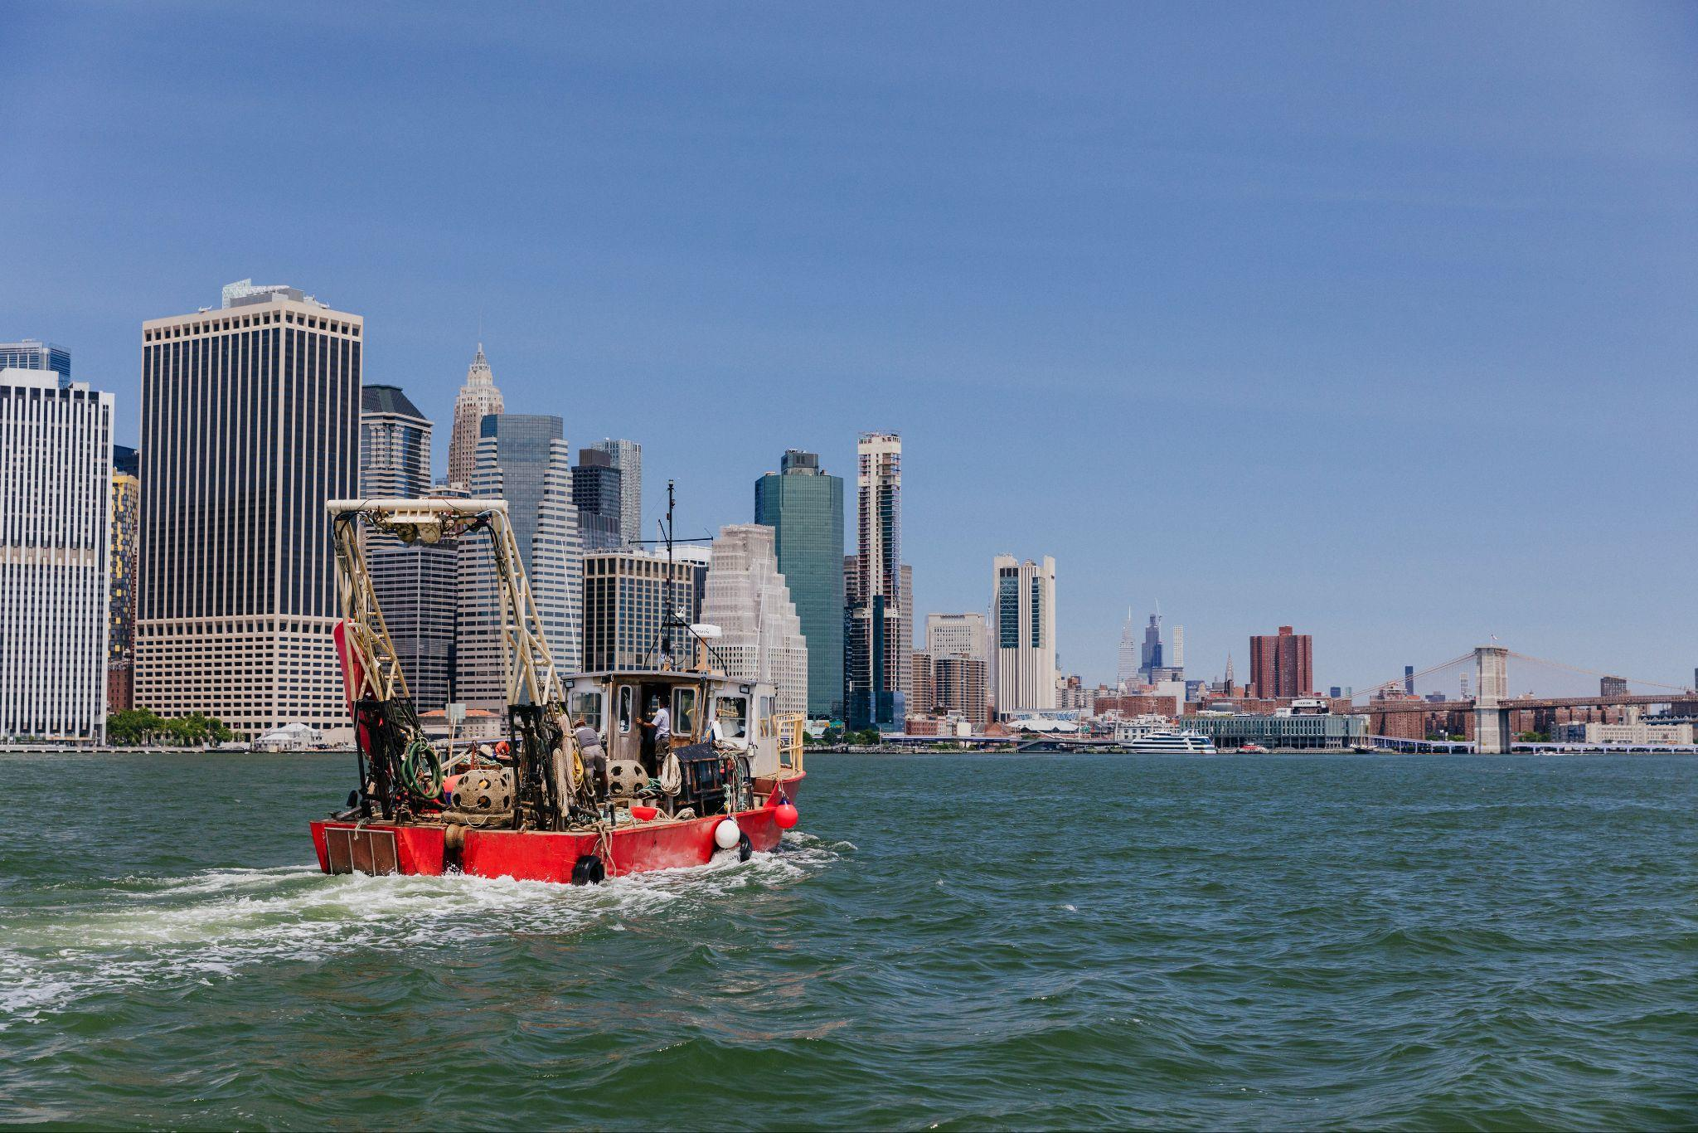
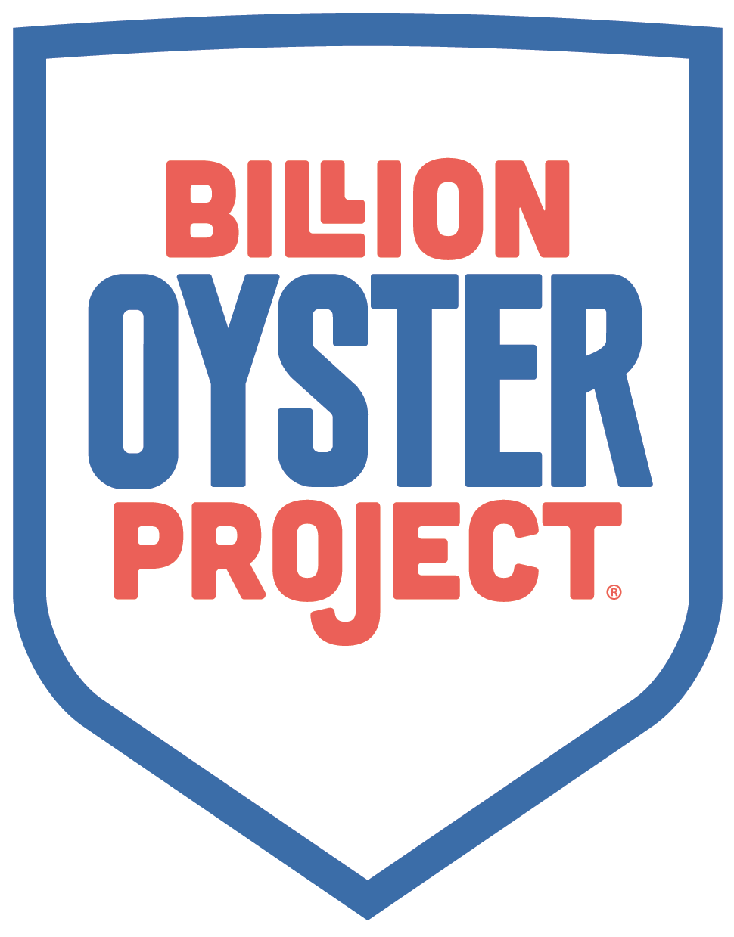
An Brief Introduction to the Billion Oyster Project
Zeke King Phillips Senior Community Stewardship Coordinator
Cody Herrmann
Senior Community Science Coordinator

Slide 2
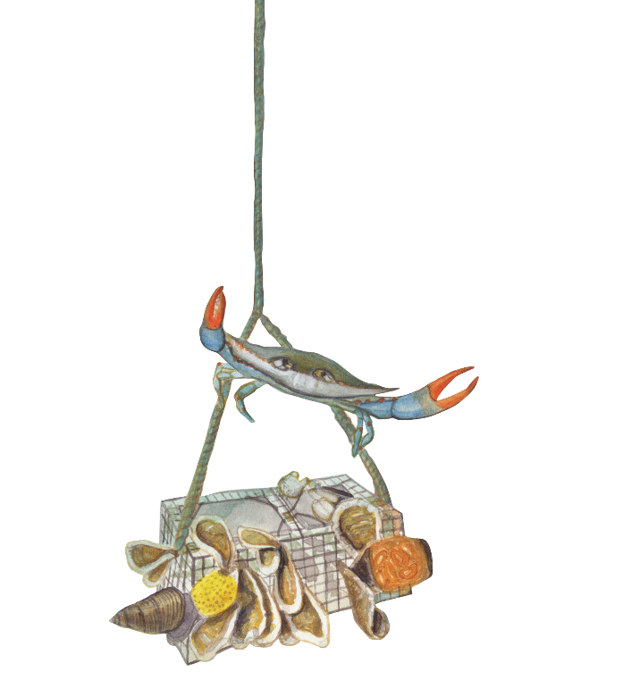
AGENDA
Introductions ✔
Billion Oyster Project Intro
Why Oysters?
Oyster Research Stations
Community Water Quality Testing
Q+A

Slide 3
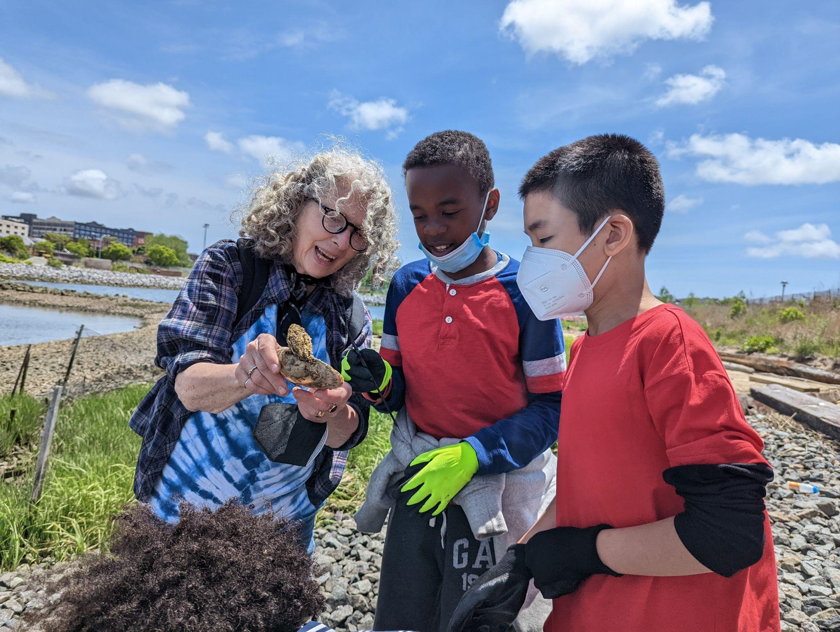
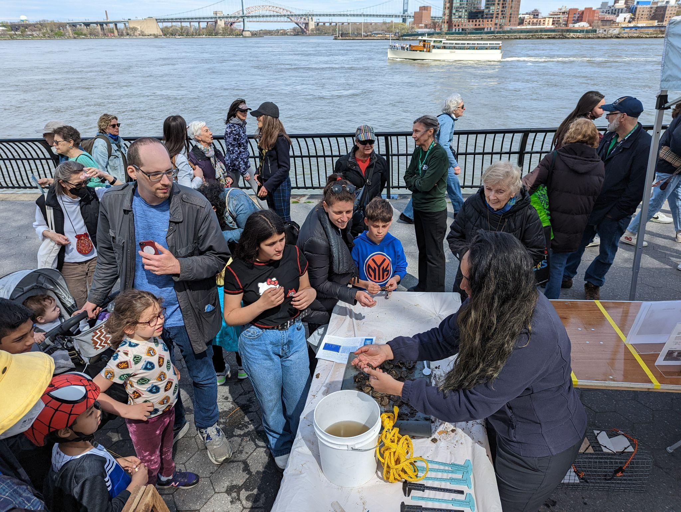
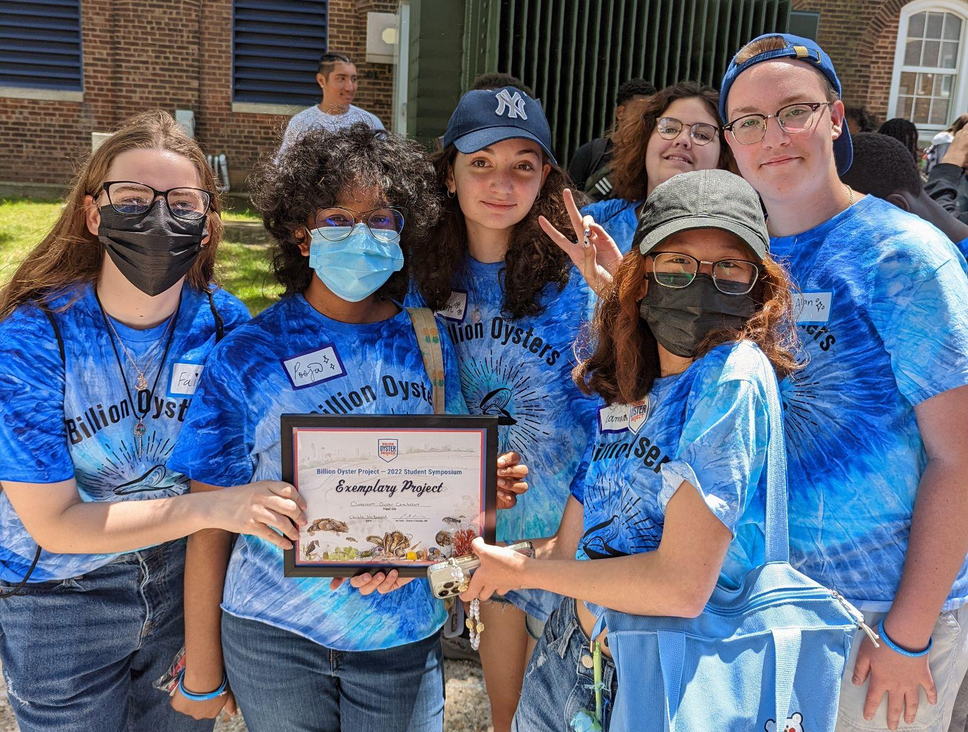
WHAT IS
BILLION OYSTER PROJECT?
Billion Oyster Project (BOP) is an ecosystem restoration and public education project aimed at restoring a sustainable oyster population and re-igniting a passion and appreciation for New York Harbor by engaging New Yorkers directly in the work of restoring one billion oysters to the estuary by 2035.

Slide 4
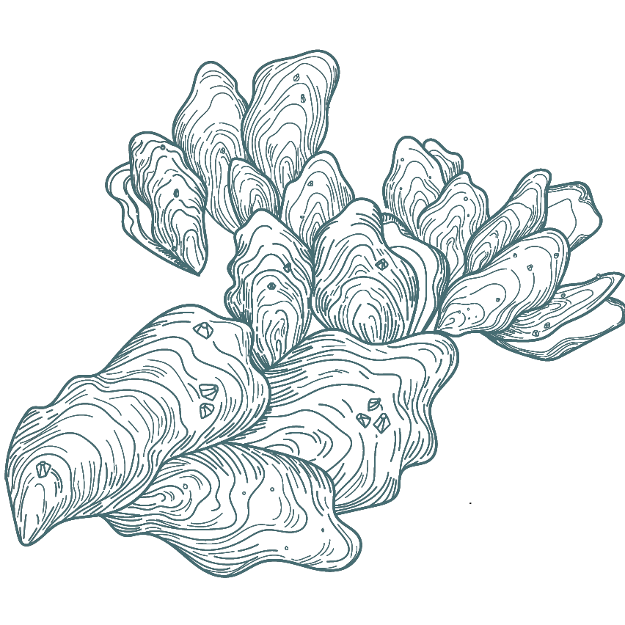
Billion Oyster Project is a non-profit working towards restoring
1 BILLION OYSTERS 1 MILLION PEOPLE into New York Harbor by 2035.
And we need your help!
Notes:
Founded on the belief that restoration without education is temporary, and observing that learning outcomes improve when students have the opportunity to work on real restoration projects, Billion Oyster Project collaborates with public schools.
The crew designs STEM curriculum for NYC schools through the lens of oyster restoration, and engages Urban Assembly New York Harbor School students in large-scale restoration projects, collects discarded oyster shells from NYC restaurants, and engages the local community.

Slide 5
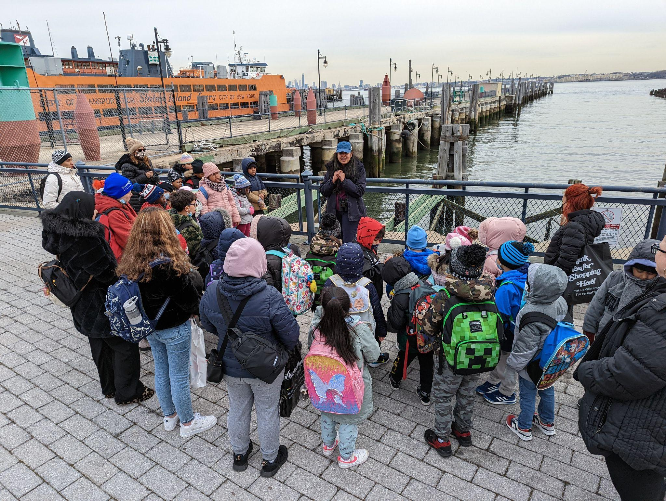
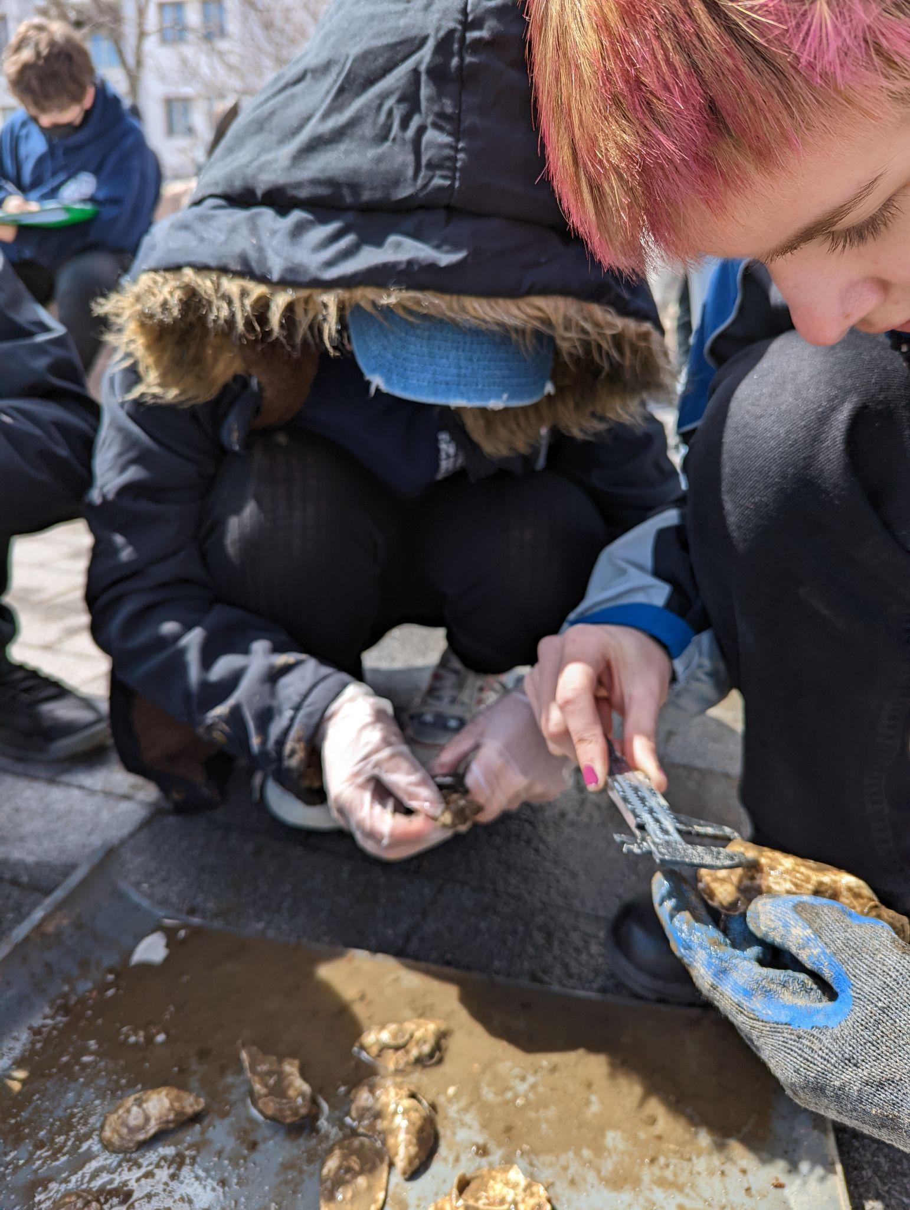
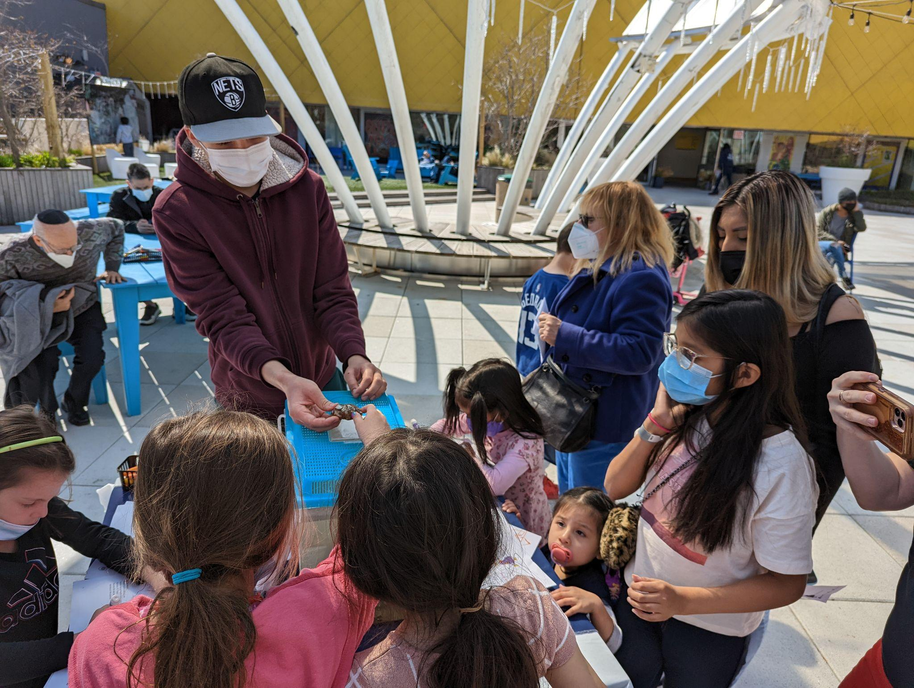
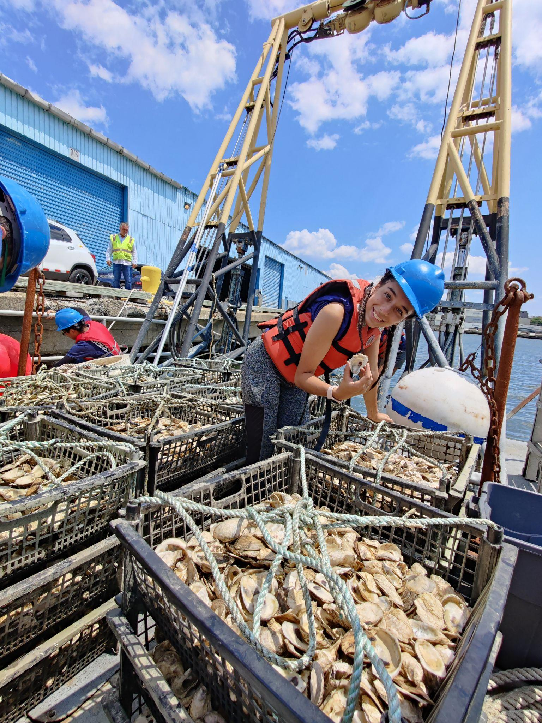
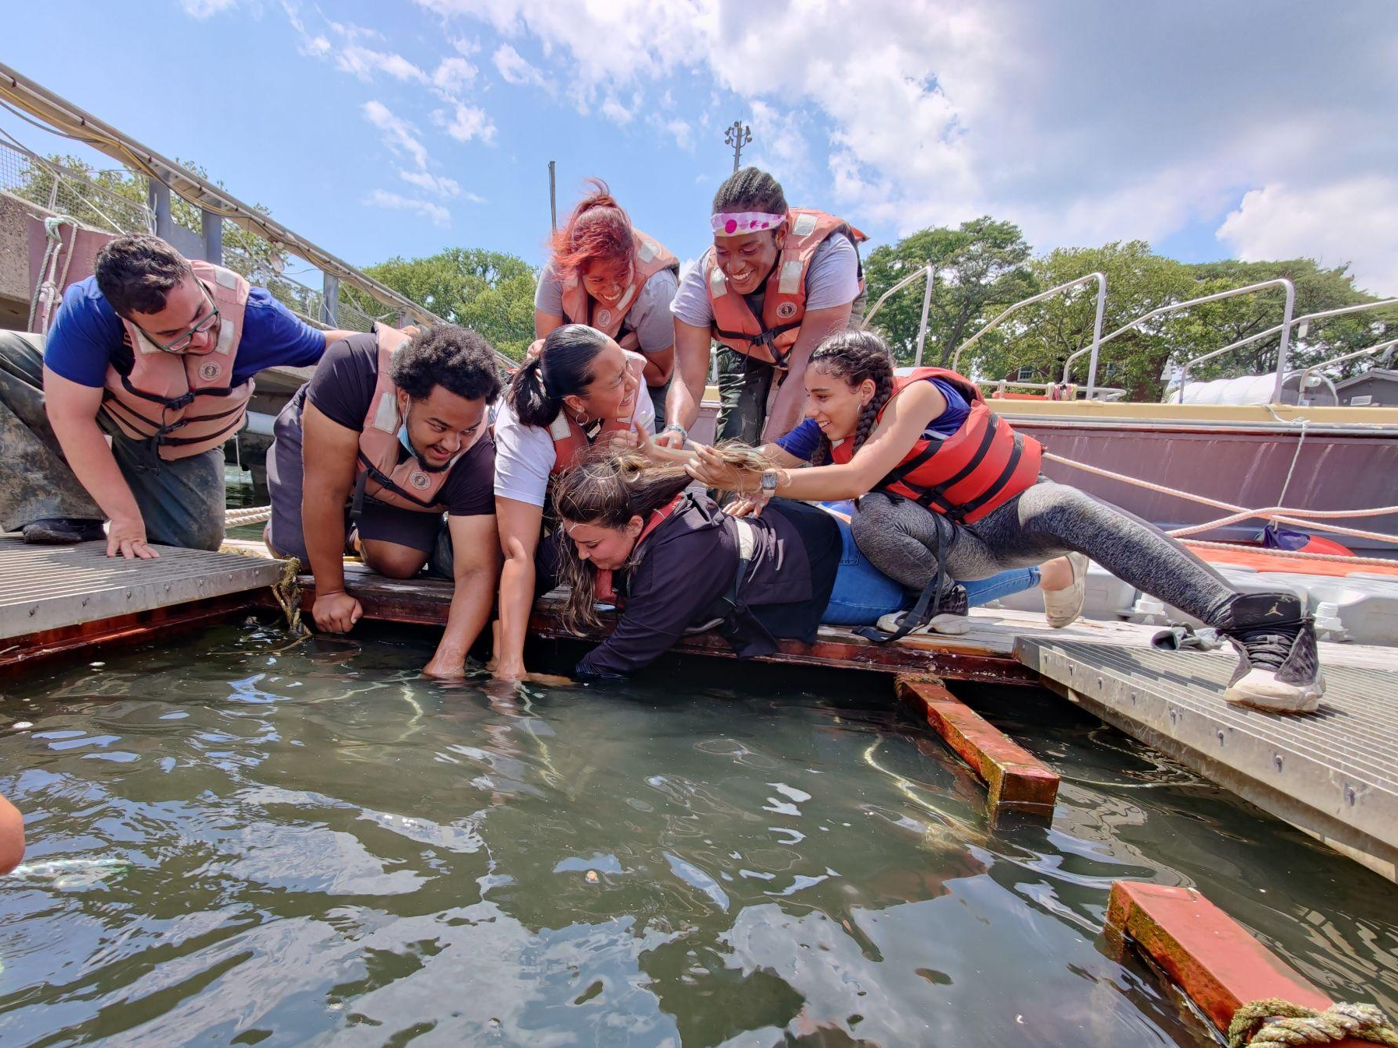
EDUCATION THROUGH RESTORATION
RESTORATION THROUGH EDUCATION
Beyond softening the blow of powerful waves that threaten our waterfront, oysters maintain a healthy ecosystem by filtering the water around them, and their reefs foster biodiversity.
Oysters also offer a social solution to climate change. Billion Oyster Project provides hands-on opportunities for our local community — from schoolchildren to retirees — to acknowledge the realities of climate change and actively adapt to them.

Slide 6

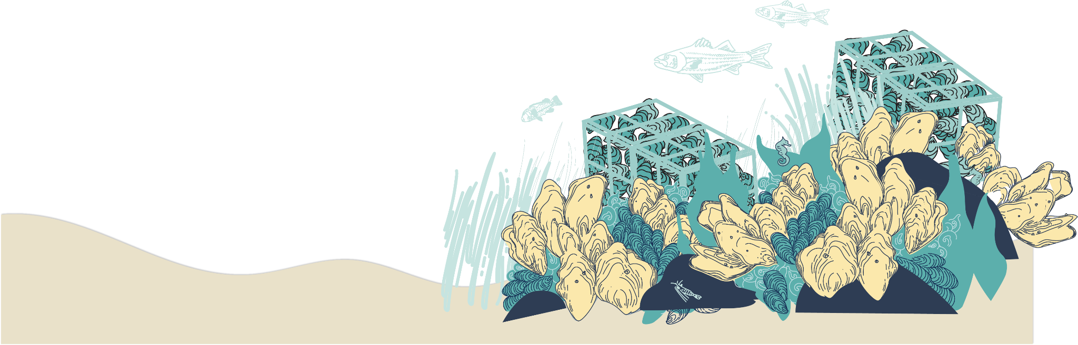
Our Process

Slide 7
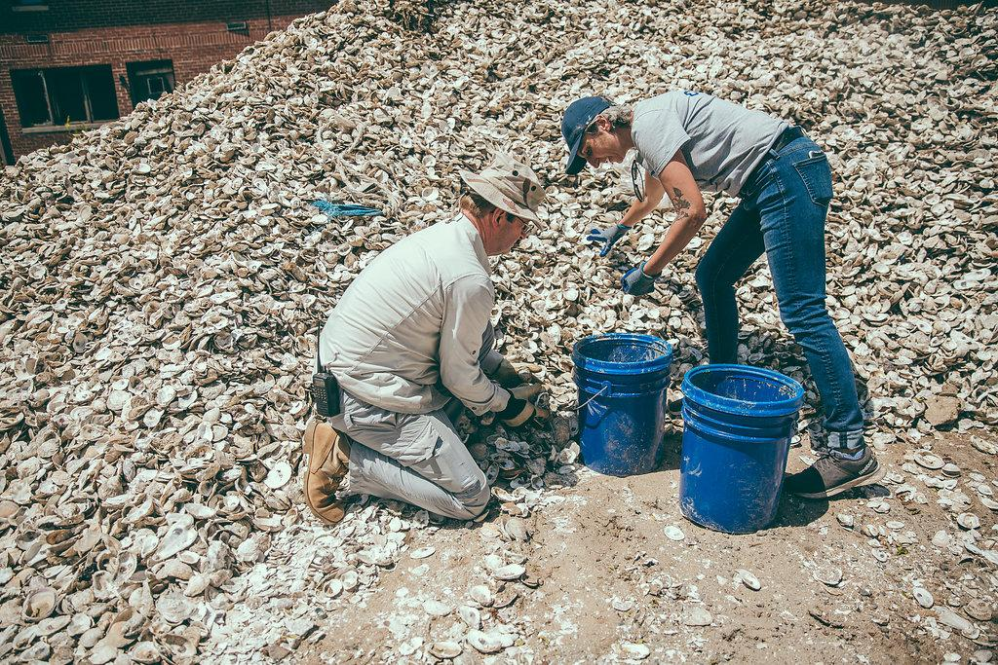
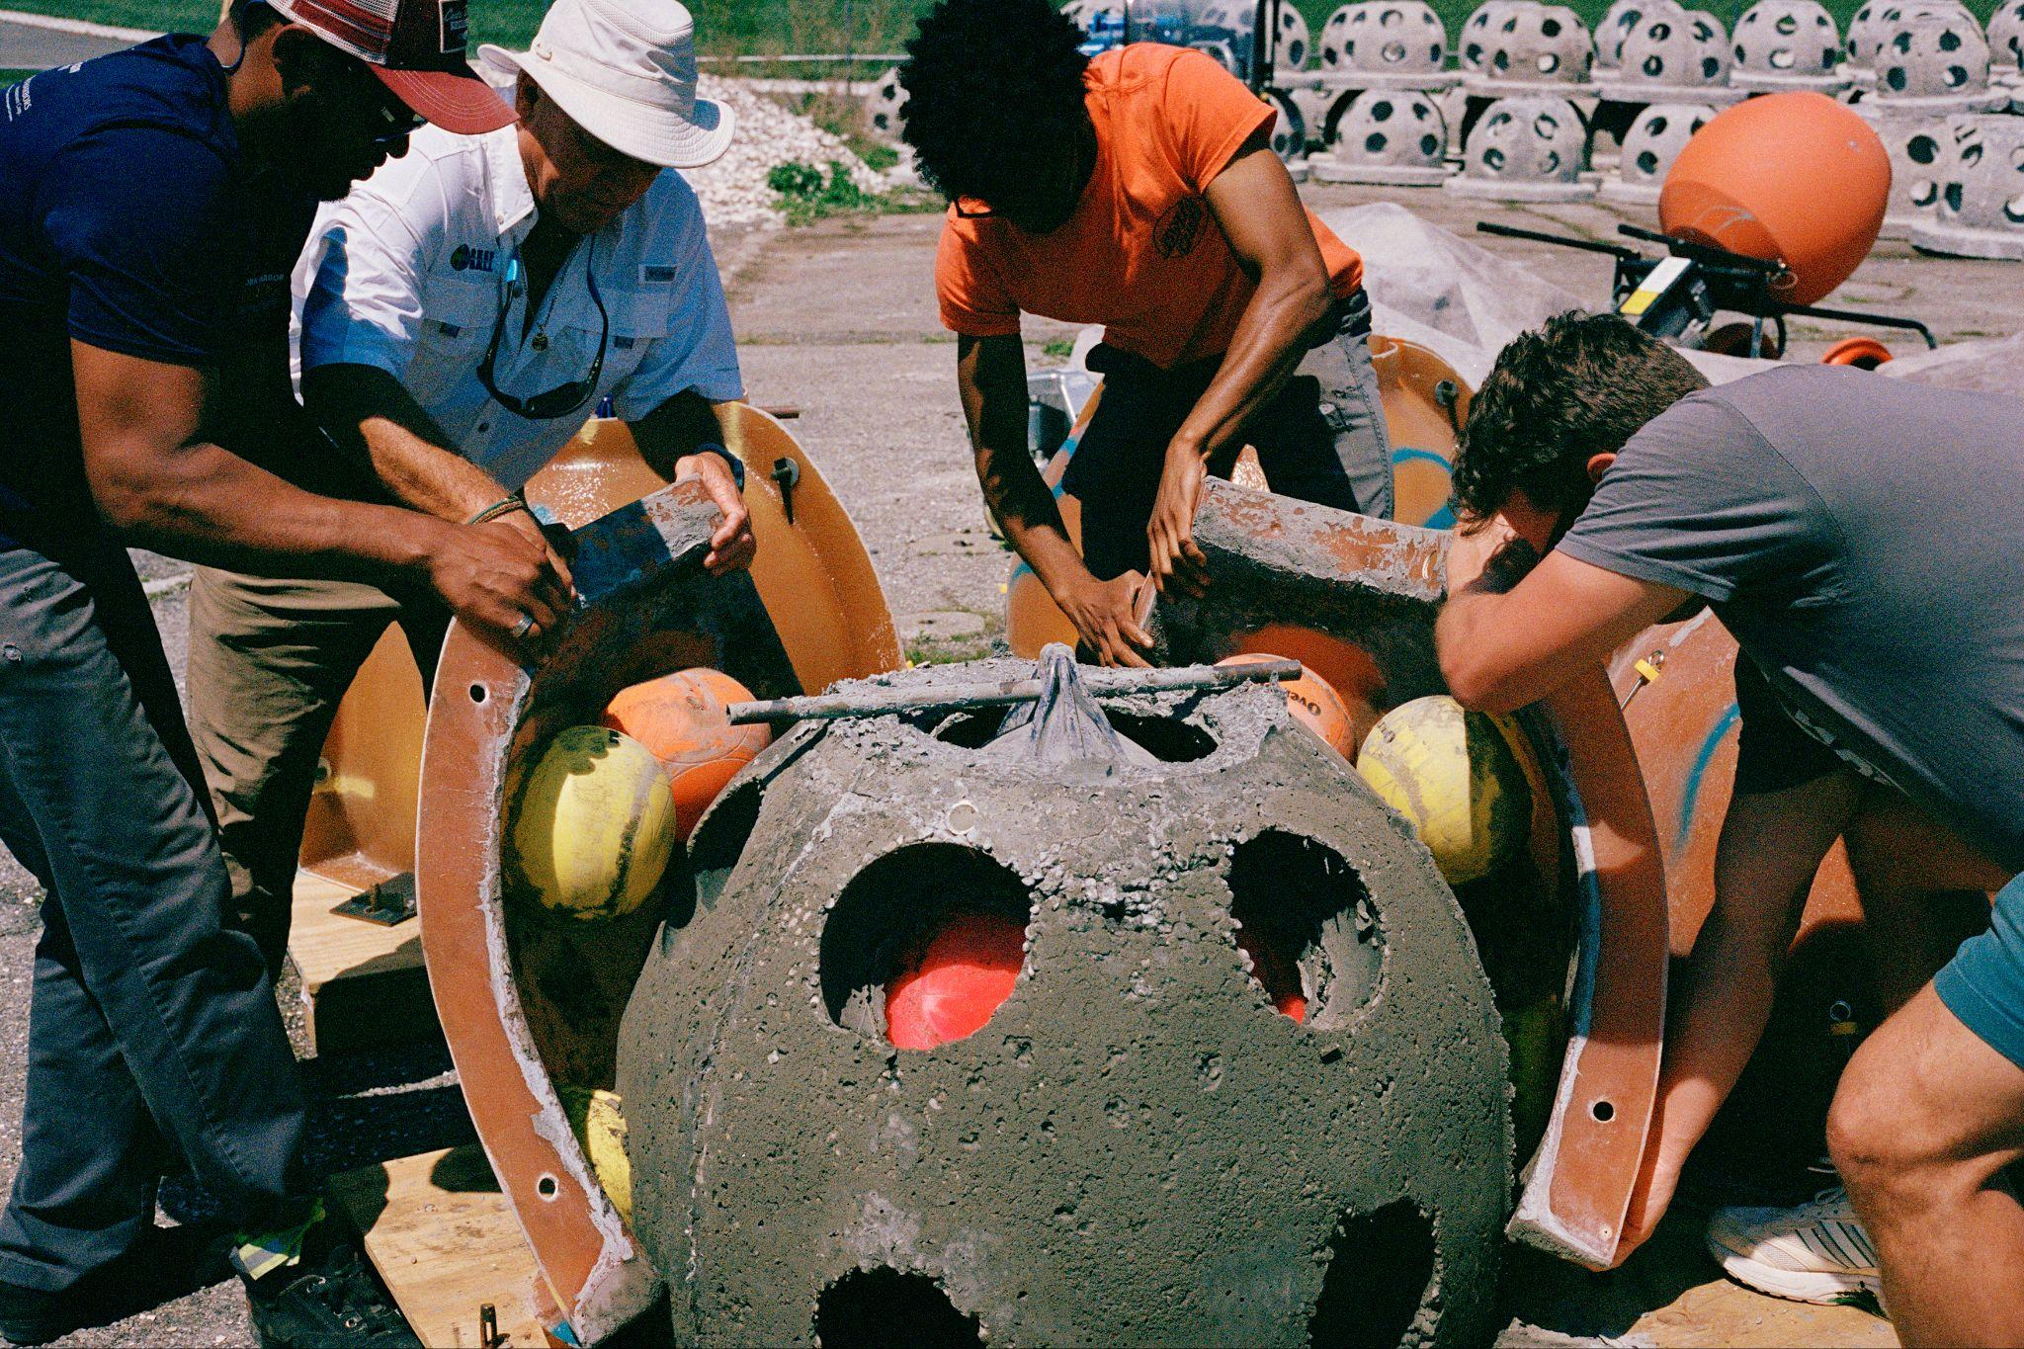
Shell Collection
Fabrication
Diverting restaurant shells from landfills
Reclaiming a valuable resource for the restoration of oyster reefs.
Collected shells are cleaned by and prepared by our volunteers for further use
Structures are built in-house by volunteers on Governors Island
ORS cages are fabricated, then filled with oysters upon deployment
Reef balls are placed directly into the setting tank, and oysters grow right on the surface

Slide 8
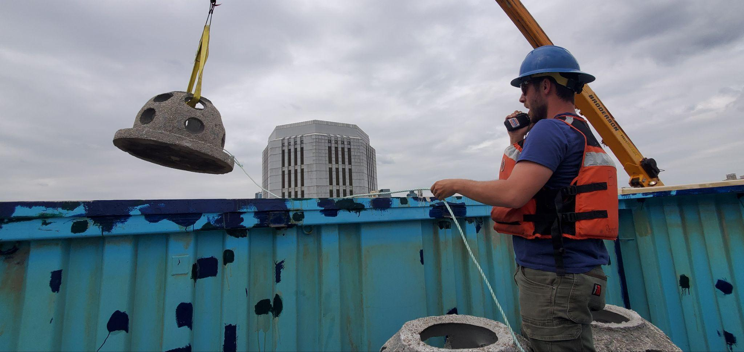
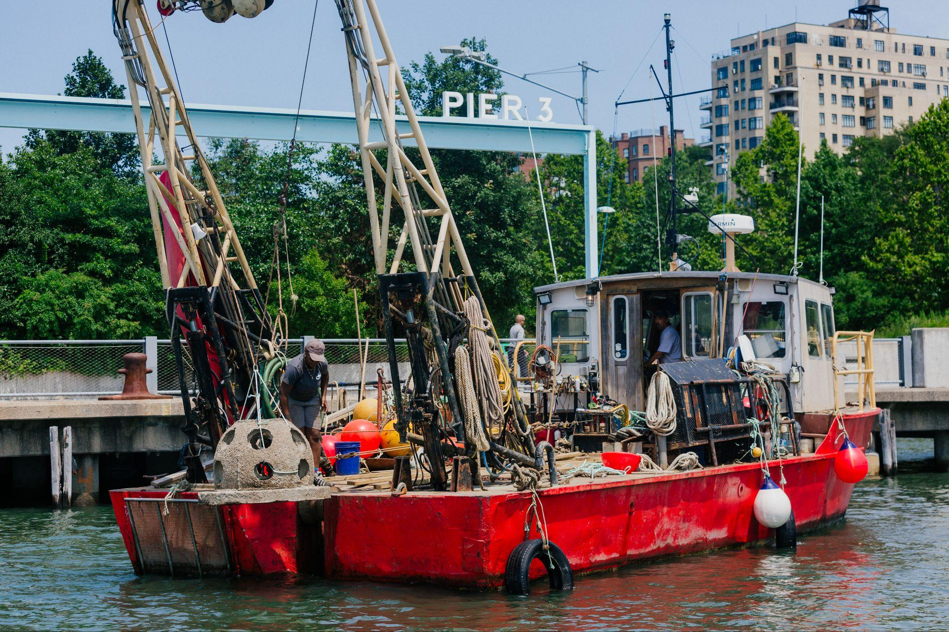
Oyster Production
Deployment
Larvae are purchased from East Coast hatcheries
Setting facility located next to Pier 101 at Governors Island
Finished reef balls are placed directly into the setting tank, and oysters growth right on the surface
Reefs installations are completed by boat
Installations can last multiple days and in multiple phases
We deploy millions of oysters at a time
~19 acres of reef across the harbor so far
Notes:
Twice the size of Bryant Park

Slide 9
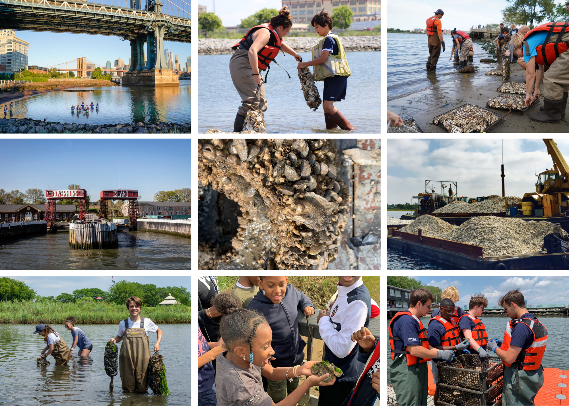
● Restored more than 150 million oysters across 19 acres of NY Harbor
● Engaged 20,000+ local students
● Engaged more than 15,000+ volunteers
● Diverted 2.5 million pounds of shell from landfills
Notes:
So far, we’ve...

Slide 10
AGENDA
Introductions ✔
Billion Oyster Project Intro ✔
Why Oysters?
Oyster Research Stations
Community Water Quality Testing
Q+A

Slide 11
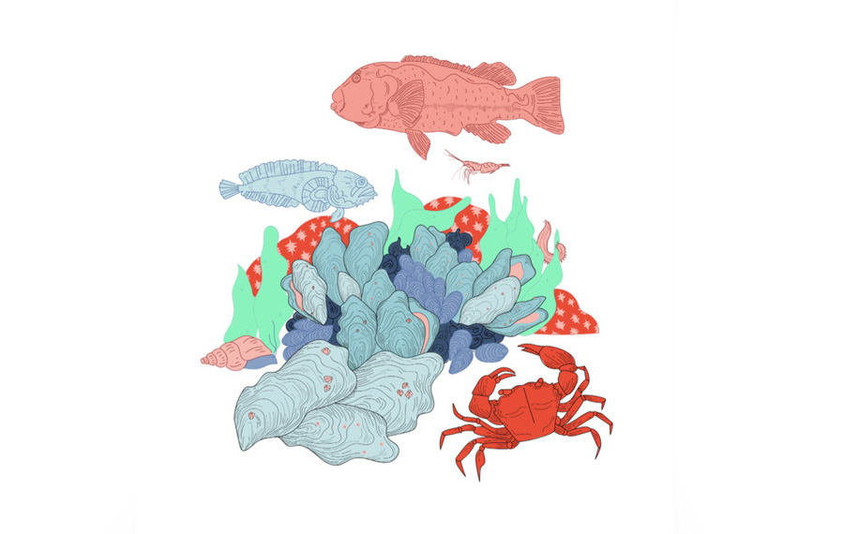
WHY OYSTERS?
Increases biodiversity
Can clear the water and move nitrogen out of the water
Can protect shorelines from wave action
Notes:
Oyster reefs (not lone oysters), affect the bacteria living in the sediment below them. Under the right conditions, oyster reefs may help speed up the process of those bacteria's taking nitrogen that is dissolved in the water - where it is a type of pollution and turns it into nitrogen gas, which ends up in the atmosphere, where it is harmless.
“Cleaning” and “filtering” language gets dangerous and encourages “magical thinking”, missing a major facet of ecology (tracing routes of matter through ecosystems, and confusing students who study global nitrogen cycle in class)
Algal blooms are not clearly linked to nitrogen pollution in NYC; compared with other estuaries that have a similar nitrogen load, we are remarkably free of algal blooms!
Possible reasons include comparatively short residence time of water in NY Harbor
turbidity so high in NY harbor that light becomes the limiting factor for algae, with the result that whatever algal blooms we do have cannot be clearly linked with nitrogen pollution levels
However, this may be changing along with the global climate, and we may have a lot more difficulty with algal blooms here in NYC in the future.
Oyster reefs could protect NYC from wave damage (not storm damage, because people think of flooding, and oysters cannot protect anyone from flooding) -- if we had enough, large enough oyster reefs to slow down the waves to an extent that would actually help people. The Living Breakwaters is an example that is projected to do so, and it is probably pretty close to being the smallest installation that could appreciably impact wave height

Slide 12
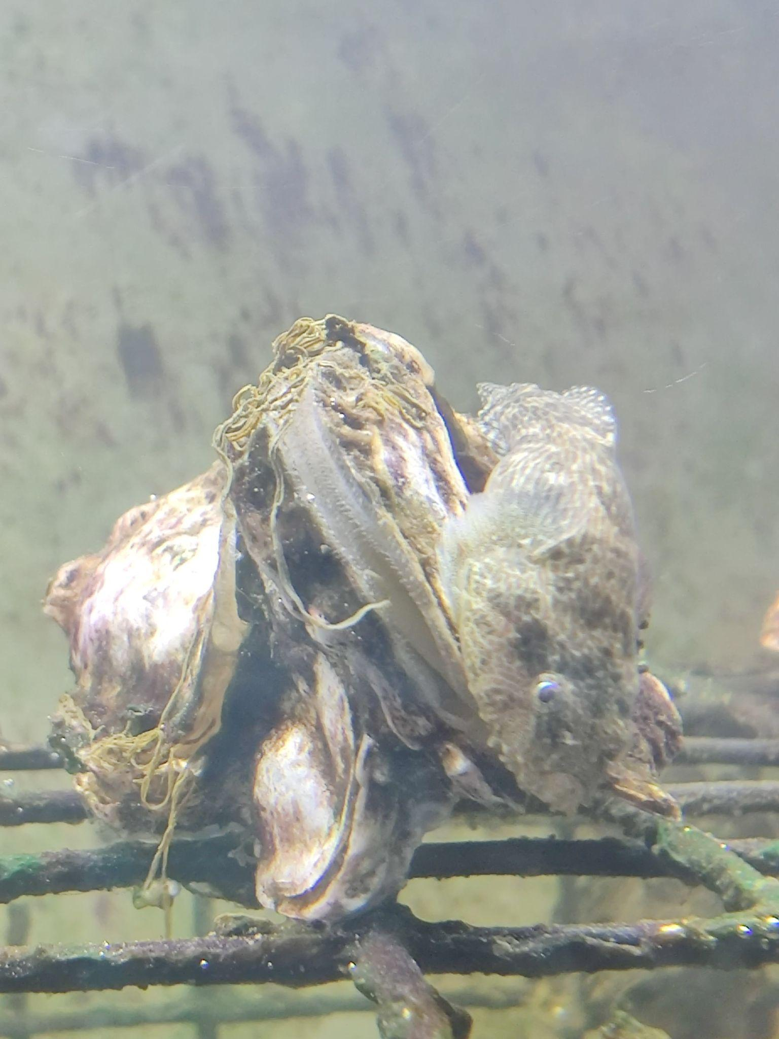
Water Filration
Oysters filter water as they eat, which helps clarify the water and remove excess nutrients, like nitrogen.
This is important to marine ecosystems, because excessive nitrogen triggers algal blooms that deplete the water of oxygen and create “dead zones.”
An adult oyster can filter up to 50 gallons of water a day, so the more live oysters you have in a body of water, the cleaner it should be.
Notes:
Oysters filter water as they eat, which helps clarify the water and remove pollutants, like nitrogen. This is important to marine ecosystems, because excessive nitrogen triggers algal blooms that deplete the water of oxygen and create “dead zones.”
Algal blooms are not clearly linked to nitrogen pollution in NYC; compared with other estuaries that have a similar nitrogen load, we are remarkably free of algal blooms!
Possible reasons include comparatively short residence time of water in NY Harbor
turbidity so high in NY harbor that light becomes the limiting factor for algae, with the result that whatever algal blooms we do have cannot be clearly linked with nitrogen pollution levels
However, this may be changing along with the global climate, and we may have a lot more difficulty with algal blooms here in NYC in the future.
An adult oyster can filter up to 50 gallons of water a day, so the more live oysters you have in a body of water, the cleaner it should be. Since the mid-1850s, New York City has relied on a Combined Sewage Overflow (CSO) system, which regularly dumps raw, untreated sewage into the Harbor when it rains. As long as this is the case, the water will not be “clean” and oysters will be dangerous to consume.
Few people are aware of CSOs and the threat they pose to human beings. Oysters are less susceptible to the effects of CSOs, however, their natural water-filtering capabilities create a major obstacle to oyster reef restoration in New York Harbor — due to regulators’ fears that contaminated oysters will be harvested and consumed.

Slide 13
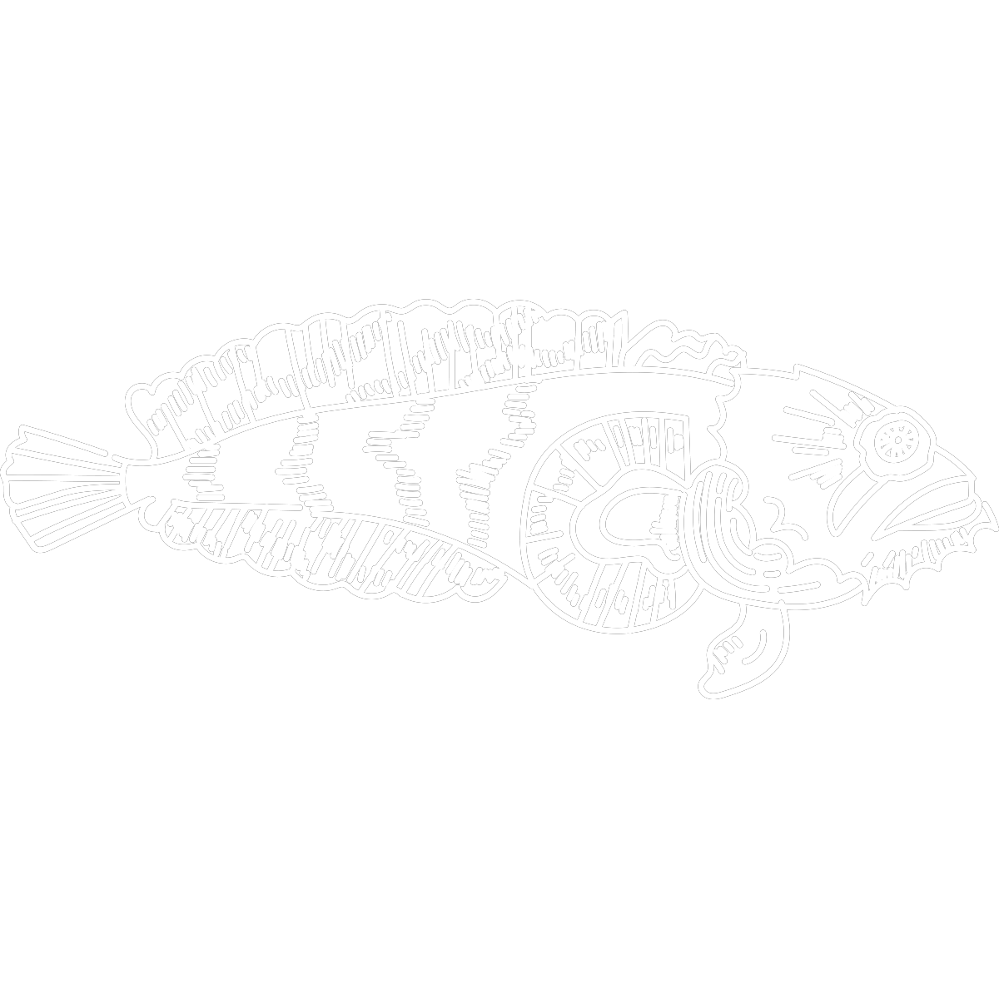
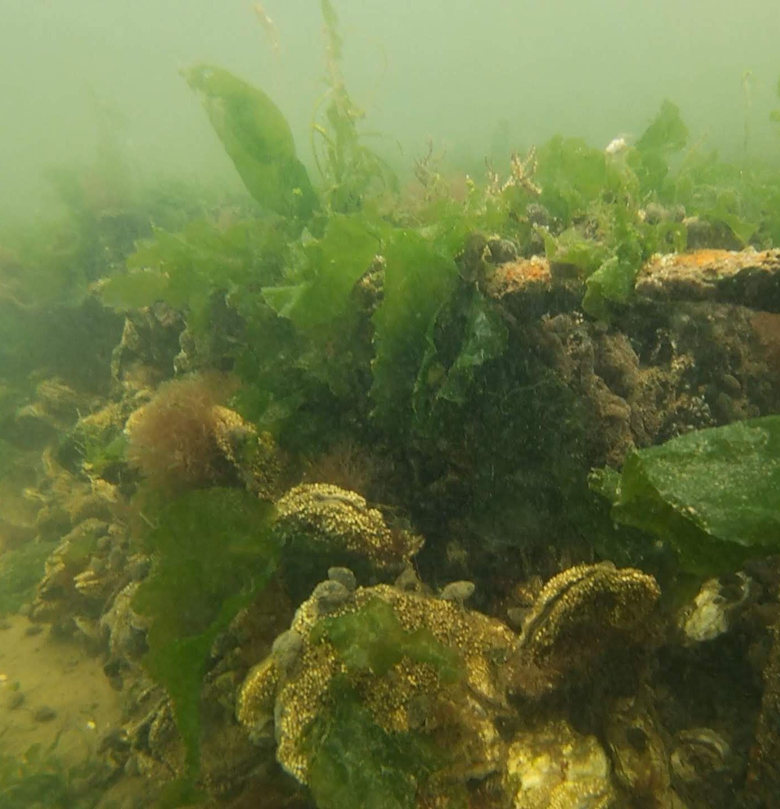
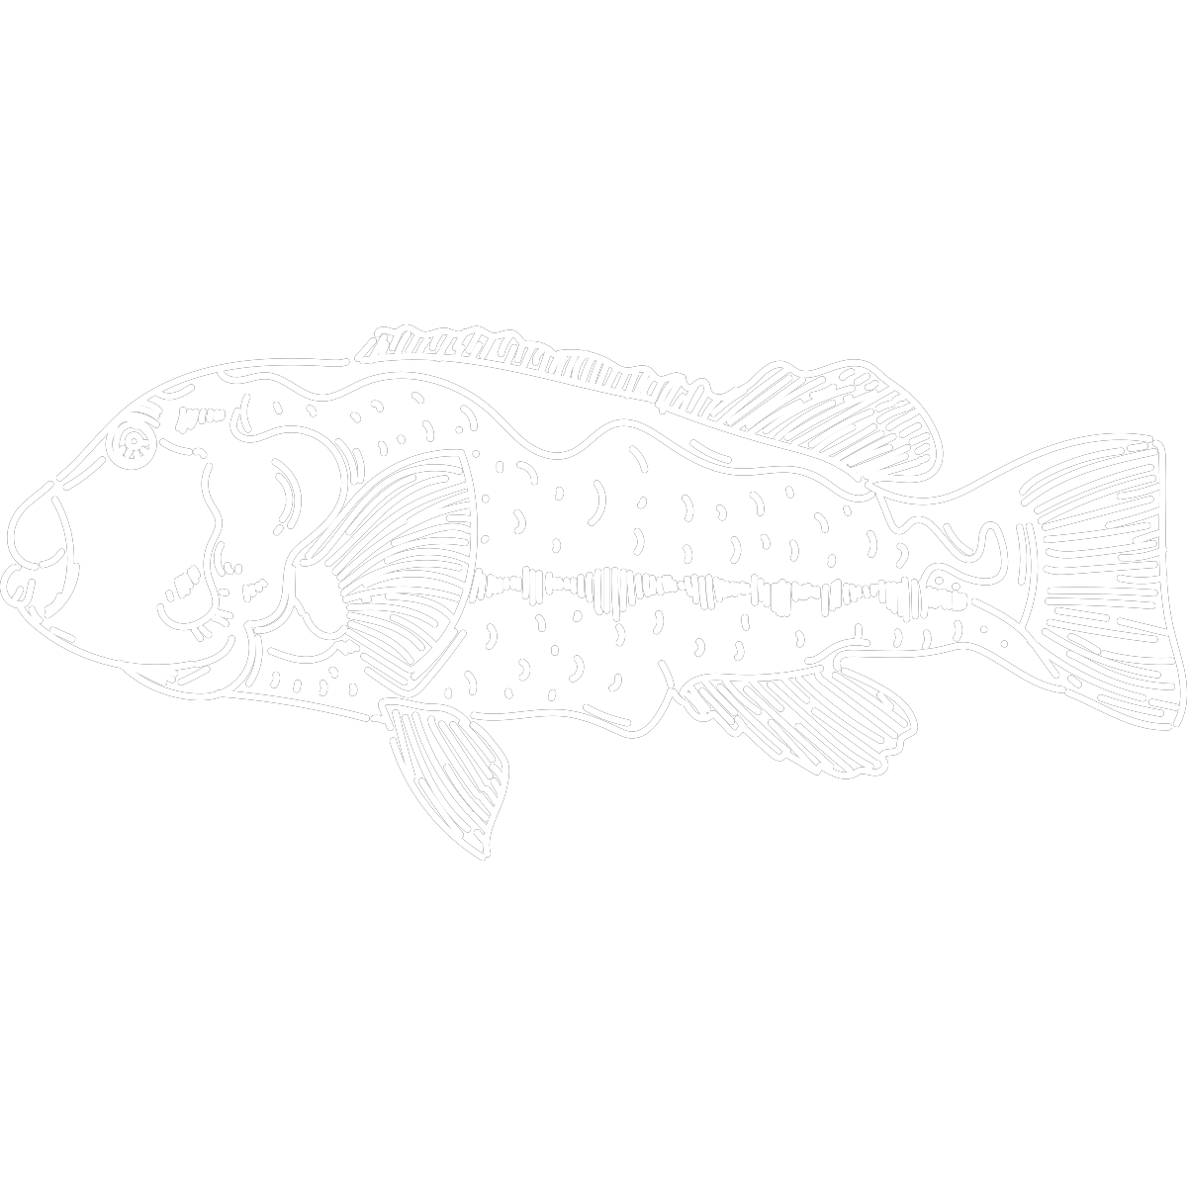
HABITAT AND BIODIVERSITY

Slide 14
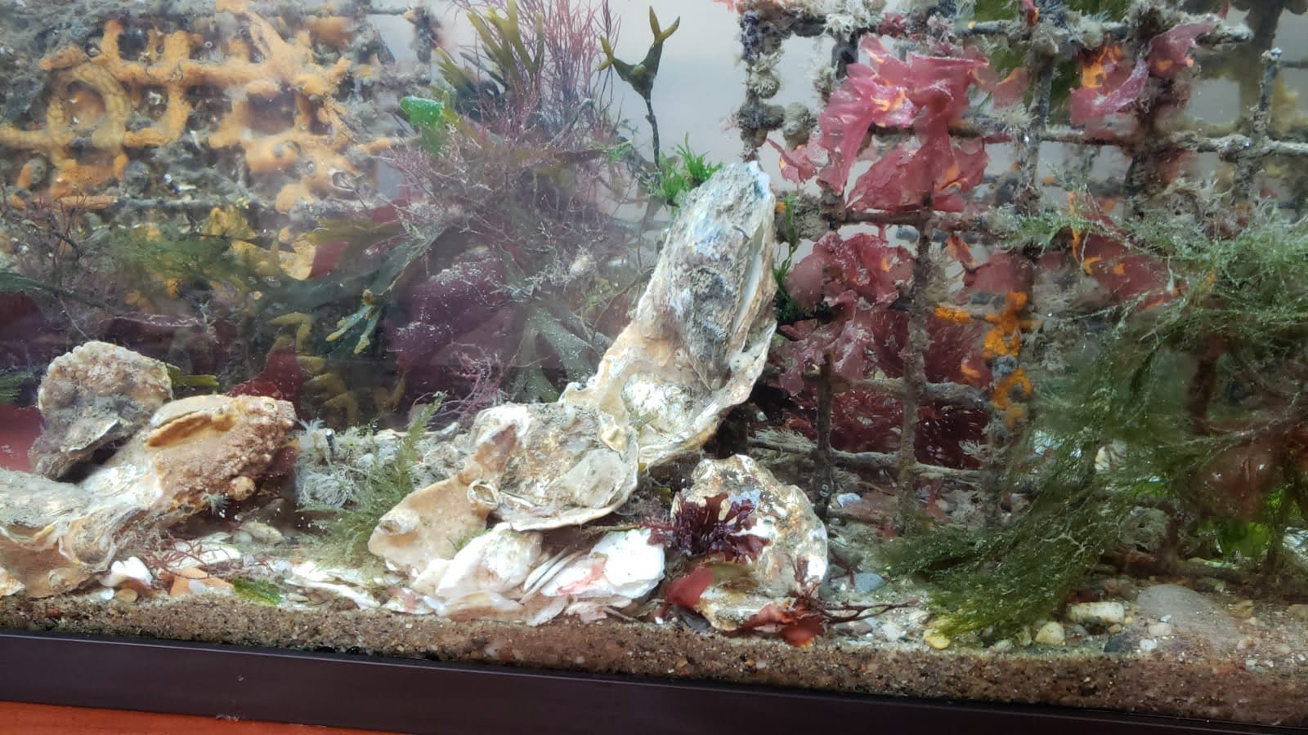
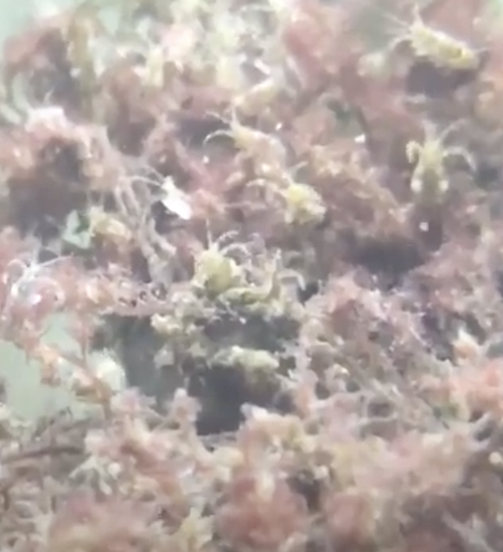
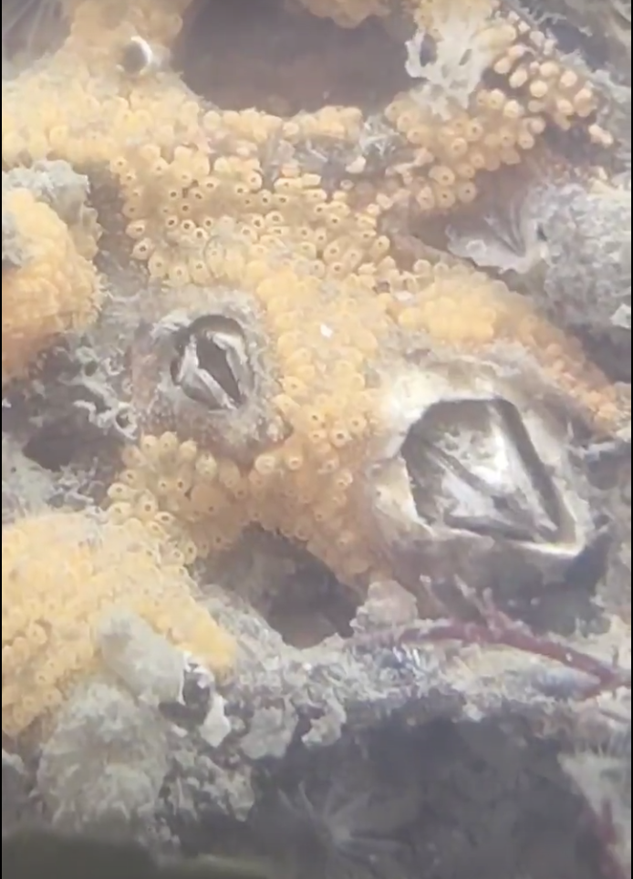
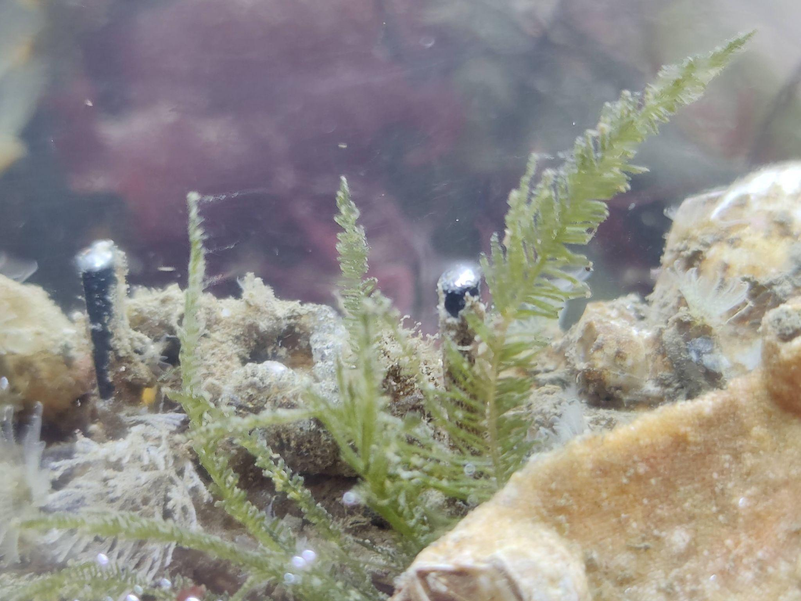
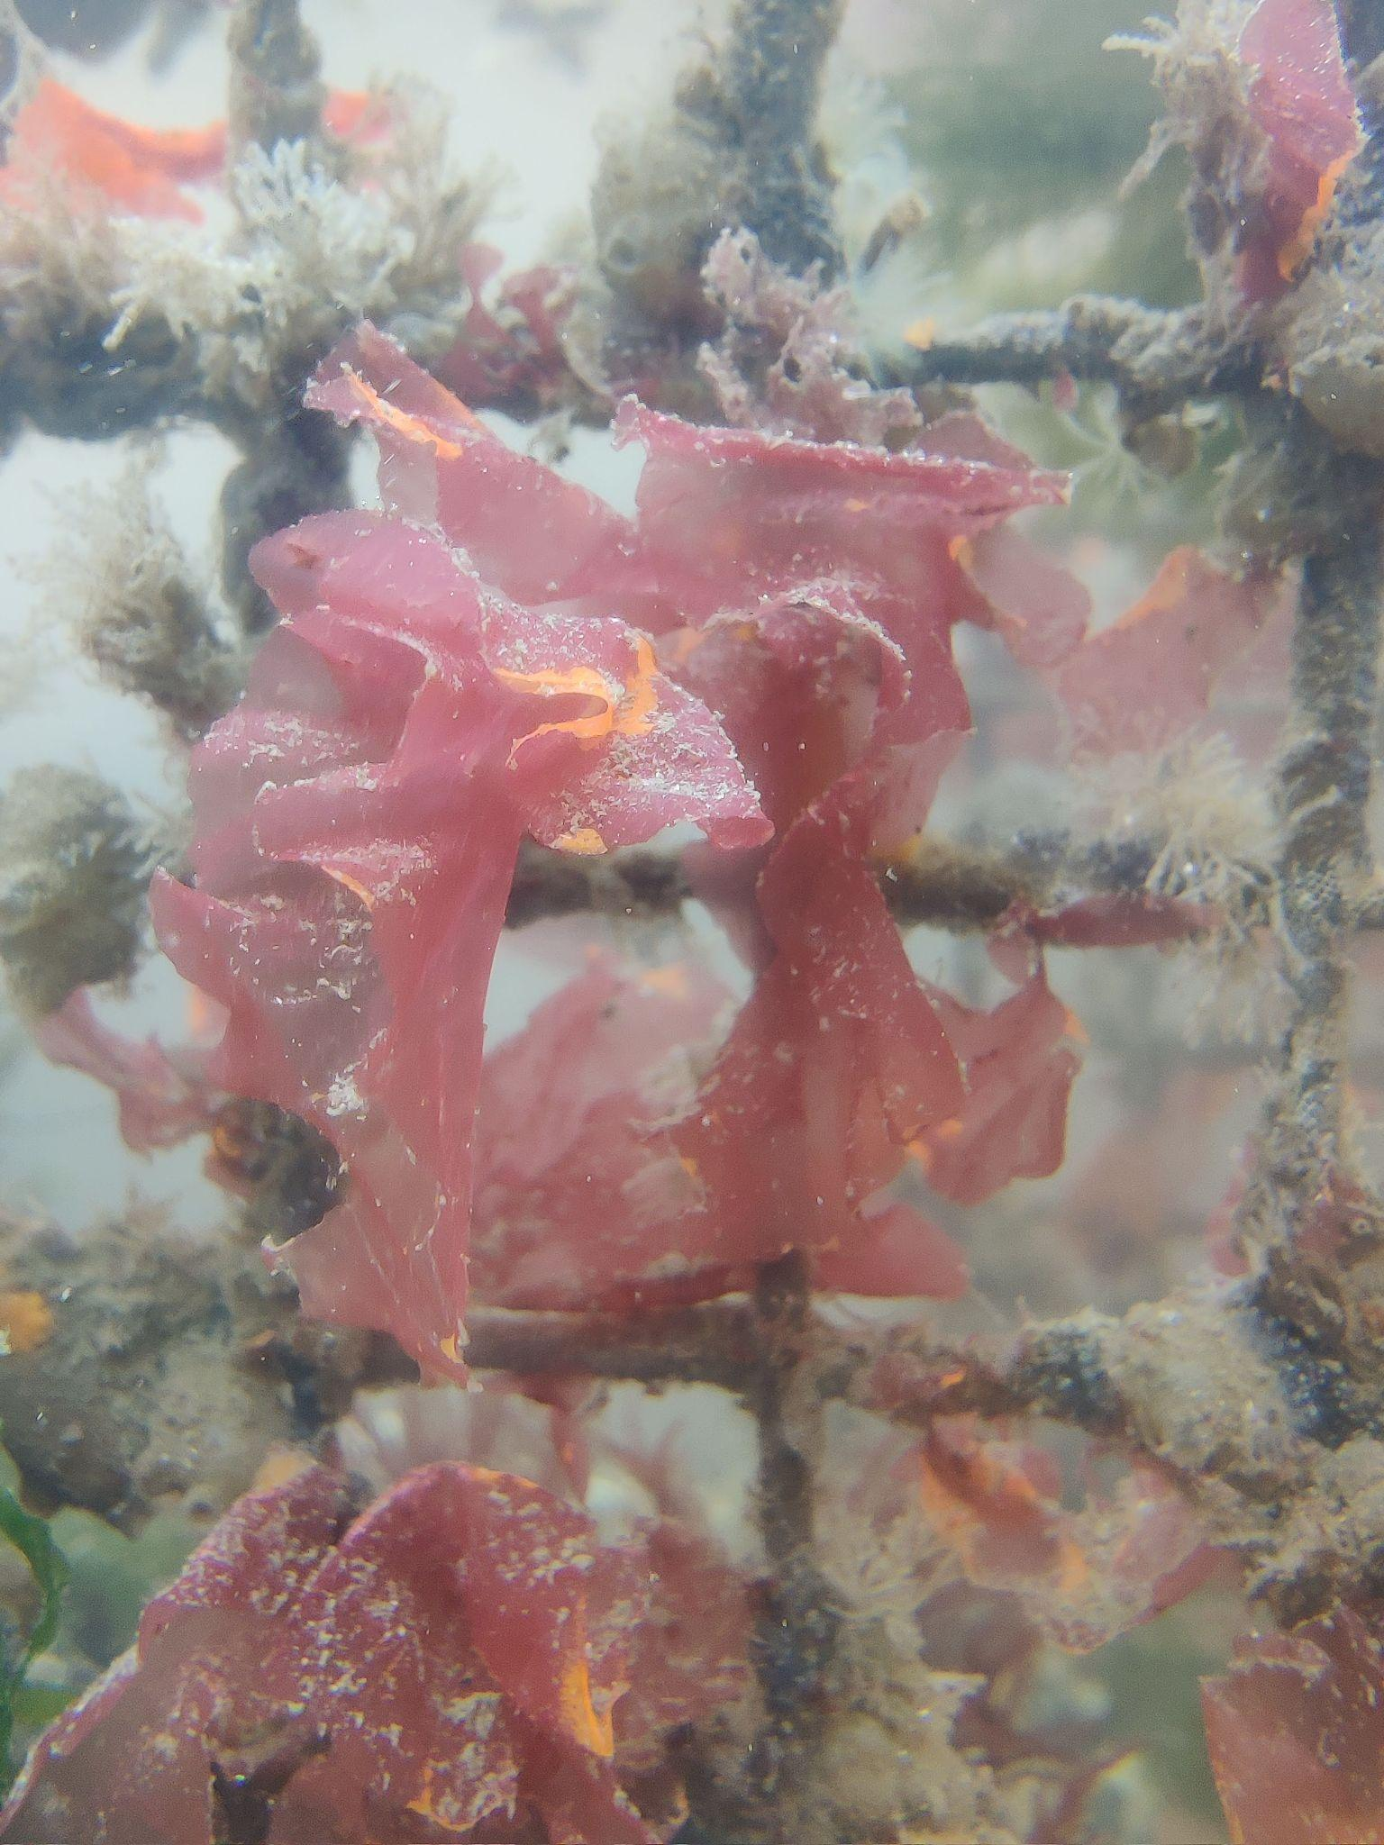
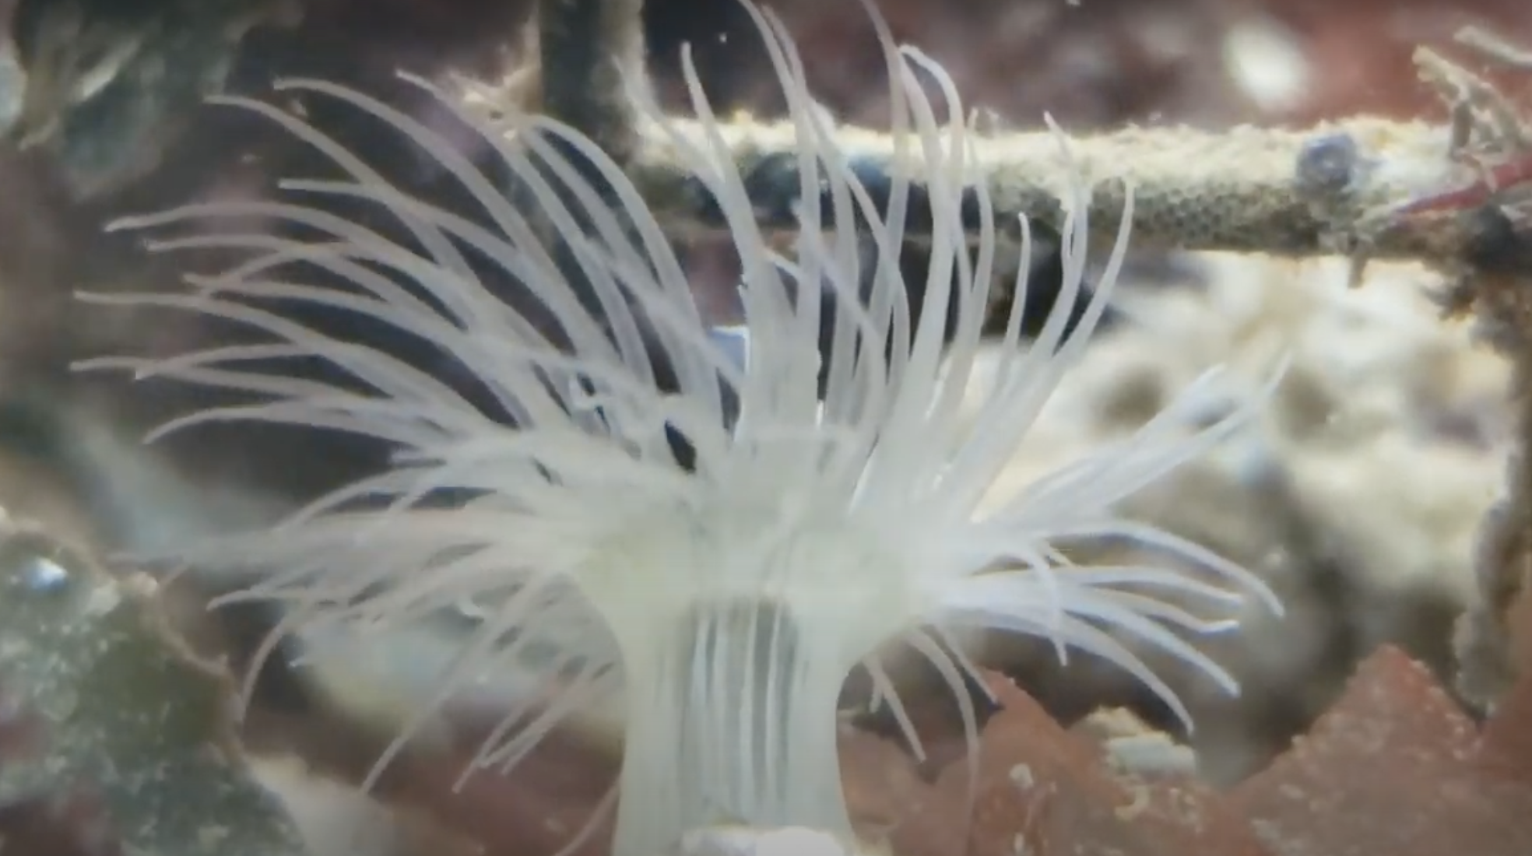
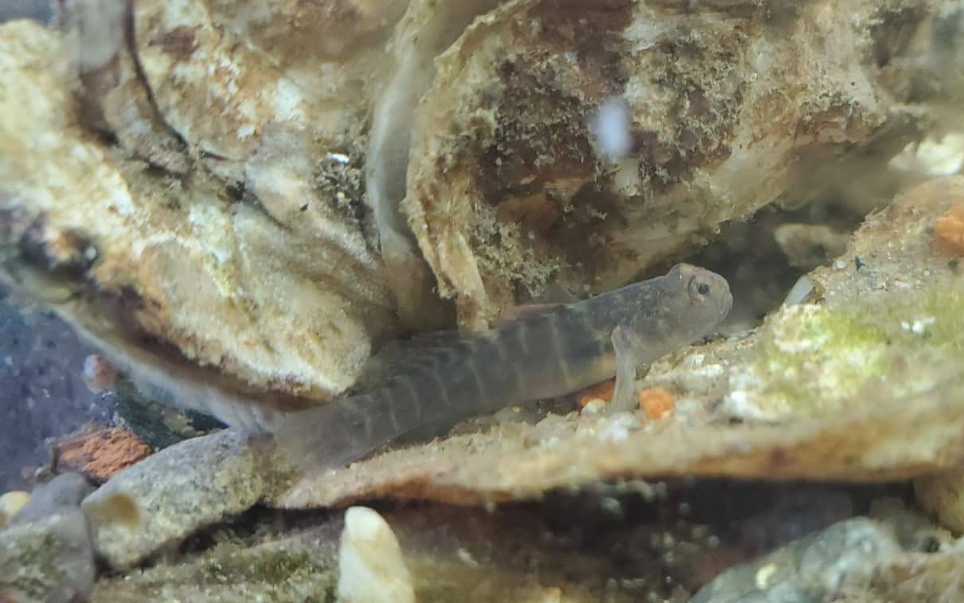
HABITAT - LET’S PLAY EYE SPY

Slide 15
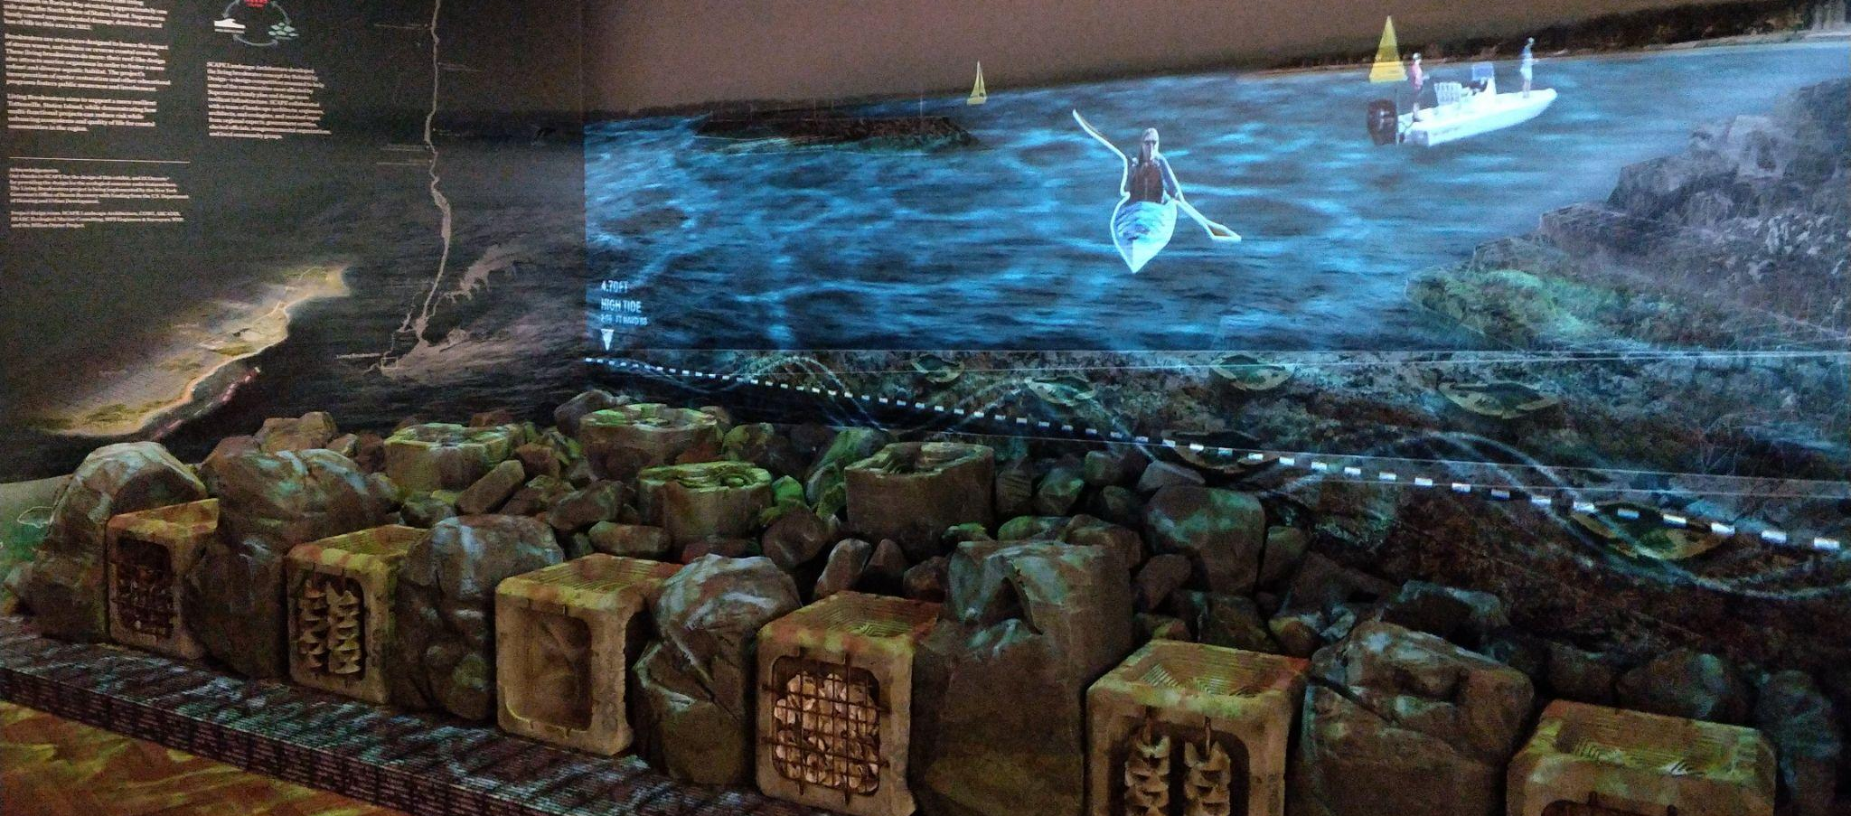
SHORELINE PROTECTION
Oyster reefs reduce wave energy, thus reducing erosive capacity
Historically, oyster reefs played a big role in protecting our shorelines, but that natural barrier was wiped out and can’t be rebuilt at a pace that matches predicted sea-level rise.
At just 33 feet above sea level, New York City is extremely vulnerable to the effects of climate change.
Oyster reefs could protect NYC from wave damage better than hardened shoreline.
Notes:
Oyster reefs could protect NYC from wave damage (not storm damage, because people think of flooding, and oysters cannot protect anyone from flooding) -- if we had enough, large enough oyster reefs to slow down the waves to an extent that would actually help people.

Slide 16
AGENDA
Introductions ✔
Billion Oyster Project Intro ✔
Why Oysters? ✔
Oyster Research Stations
Community Water Quality Testing
Q+A

Slide 17
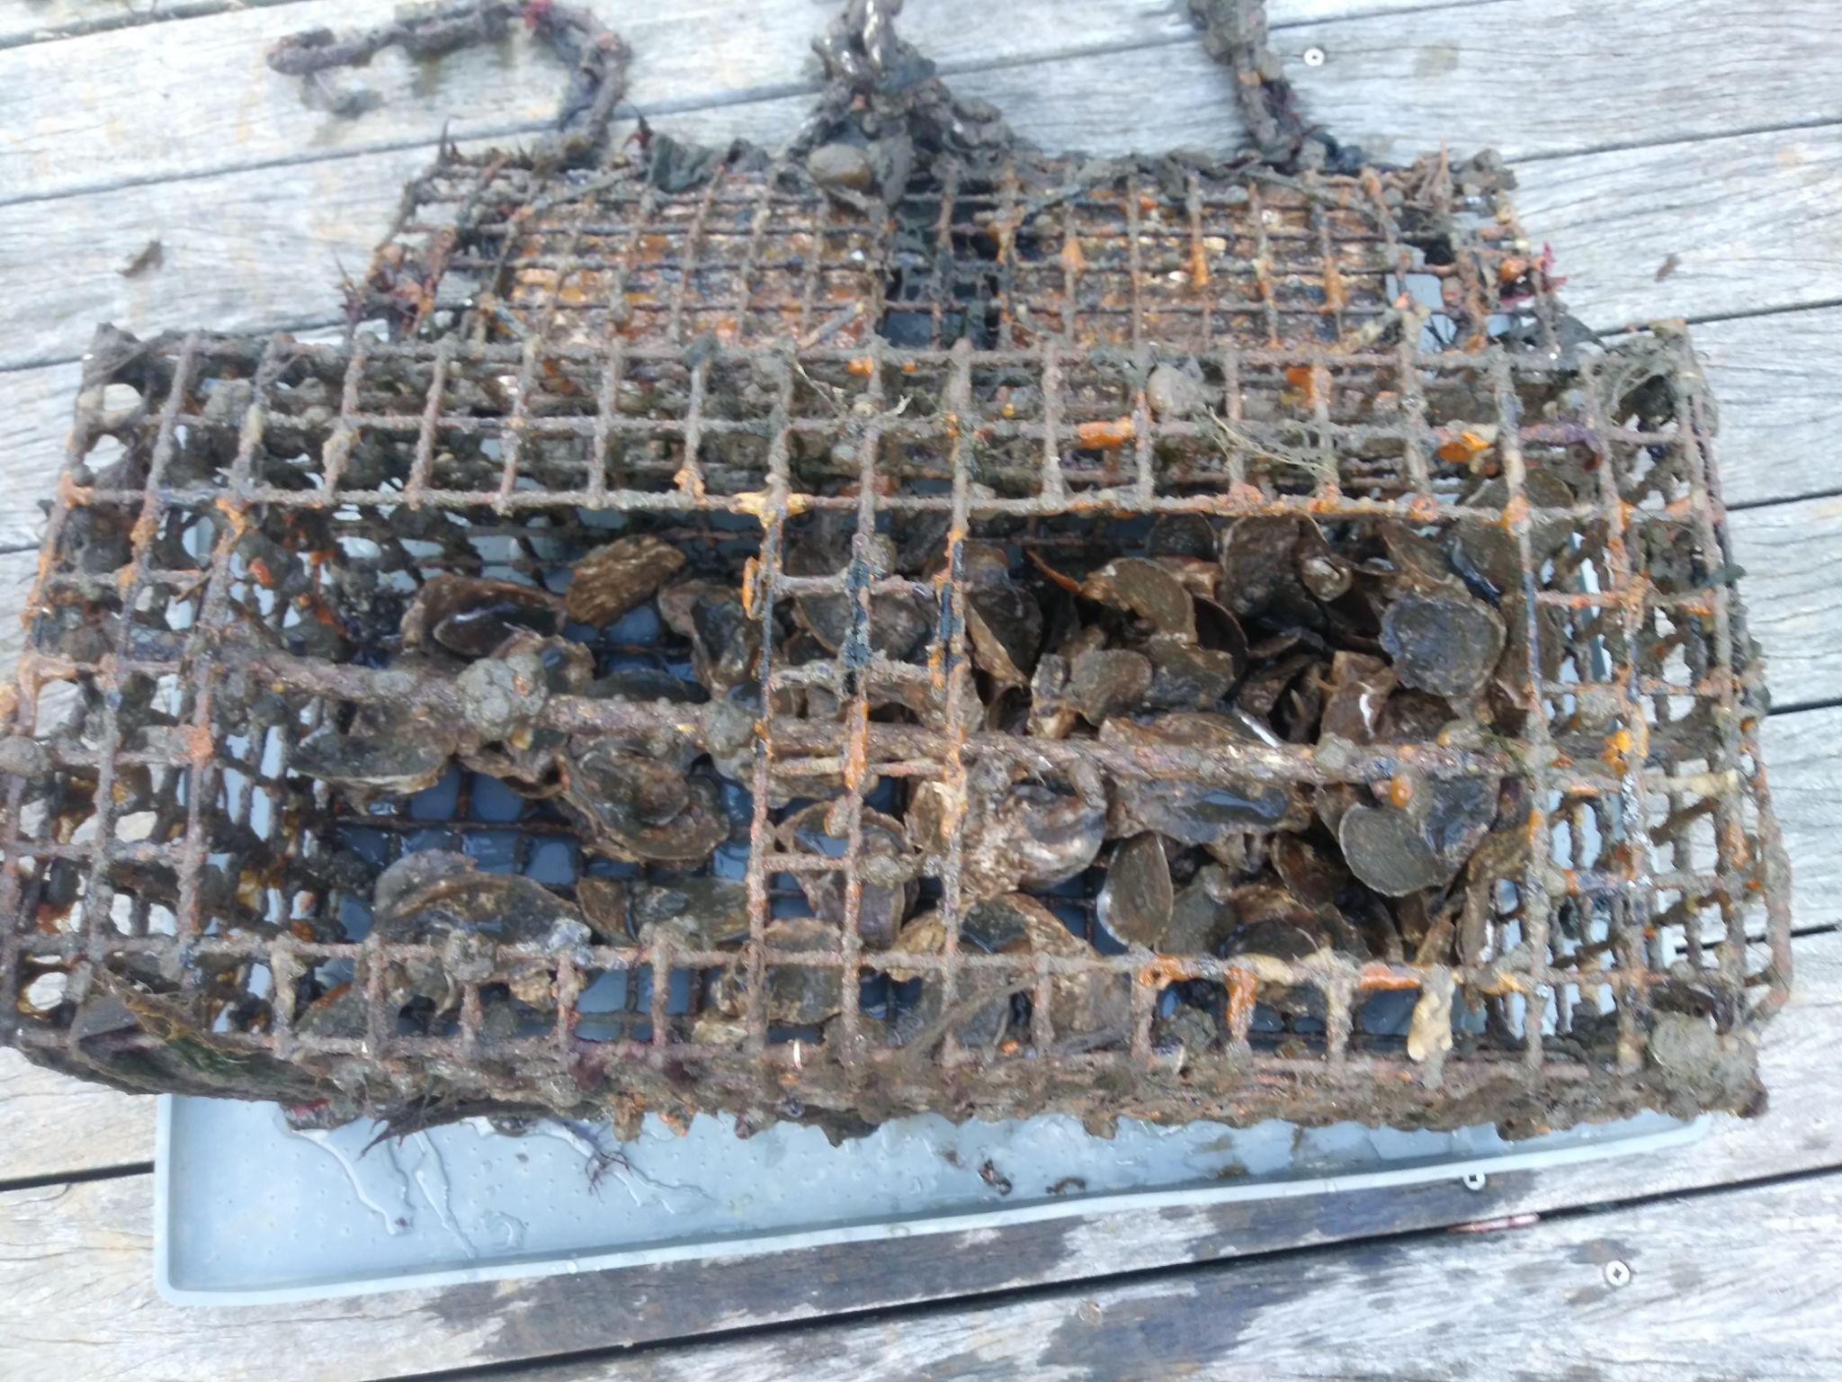
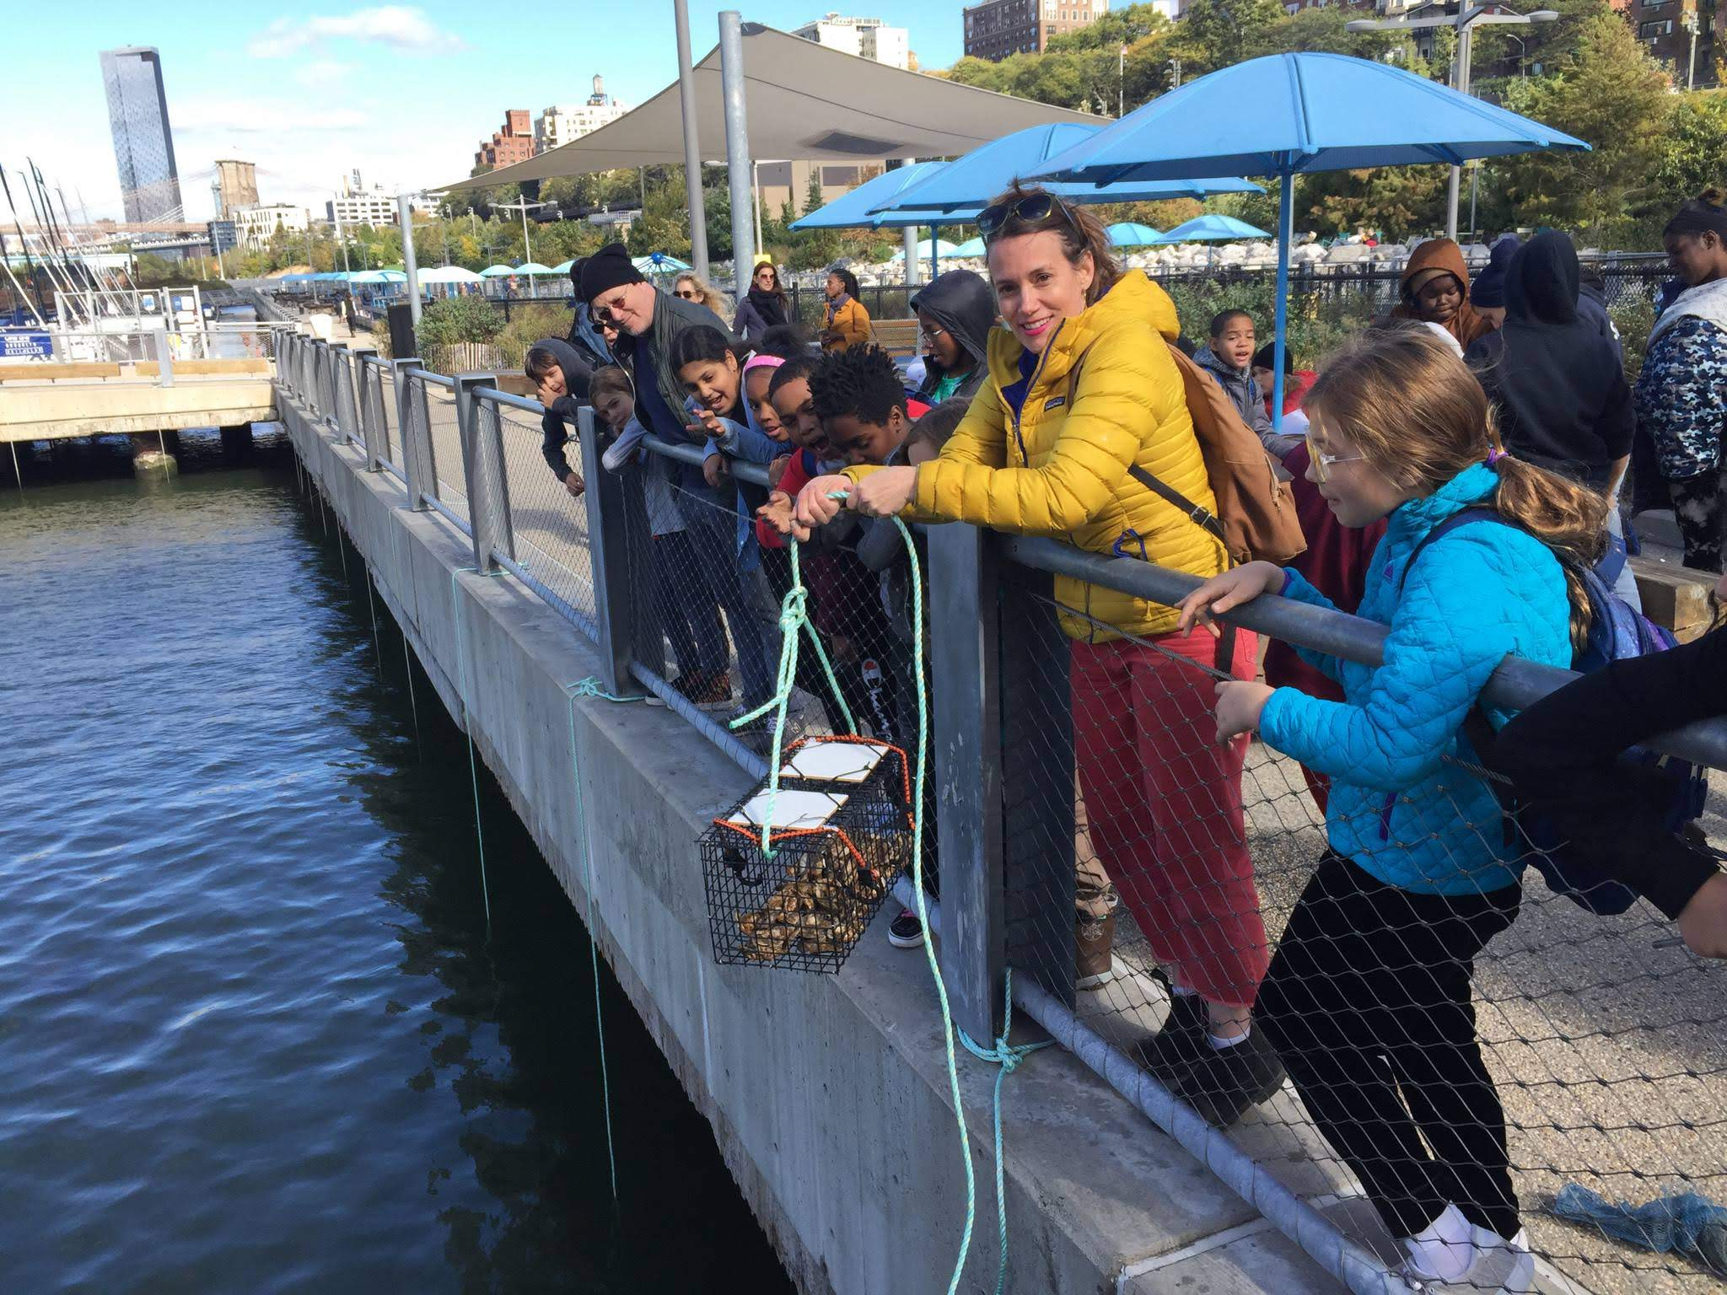
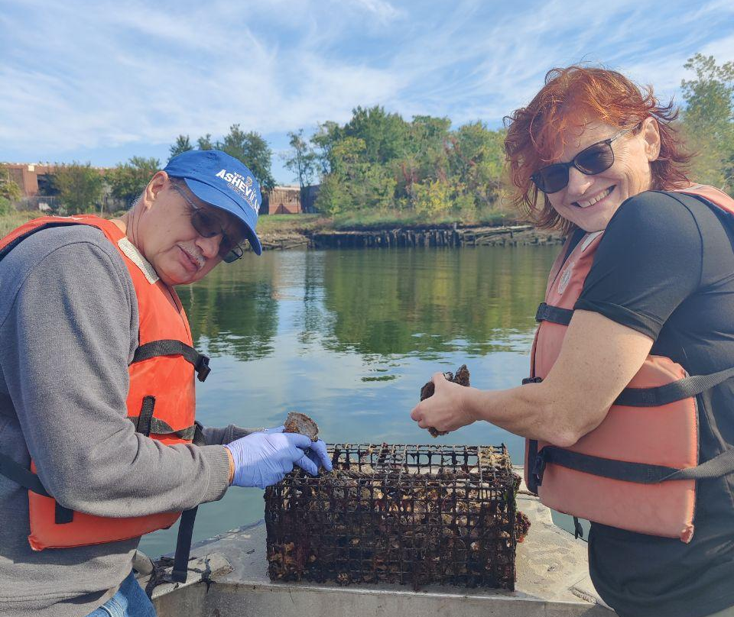
OYSTER RESEARCH STATIONS
An Oyster Research Station (ORS) is an in-situ experimental laboratory attached to a dock, bulkhead, or floating buoy by a marine poly line. In layman’s terms, it is a simple mesh cage fabricated in-house at Billion Oyster Project that will house up to 200 live oyster for scientific monitoring.
WHY PARTICIPATE IN THE PROGRAM?
Contribute to the restoration of New York Harbor’s ecosystem
Join a community of like minded individuals interested in climate and sustainability
Notes:
The ORS is meant to be used as an educational tool for teachers, students, and community scientists that want to study the NY harbor through hands-on monitoring and scientific experimentation at the water’s edge.
We are all here for the students of NYC, as well as the generations to come. Participating in the ORS program means a commitment to a more biodiverse, clean, and resilient NY harbor. Part of that means supporting student inquiry wherever and whenever possible (begin asking yourself, how do I want to get my family, community, or students involved?) and modeling that yes, anyone can be a scientist!

Slide 18
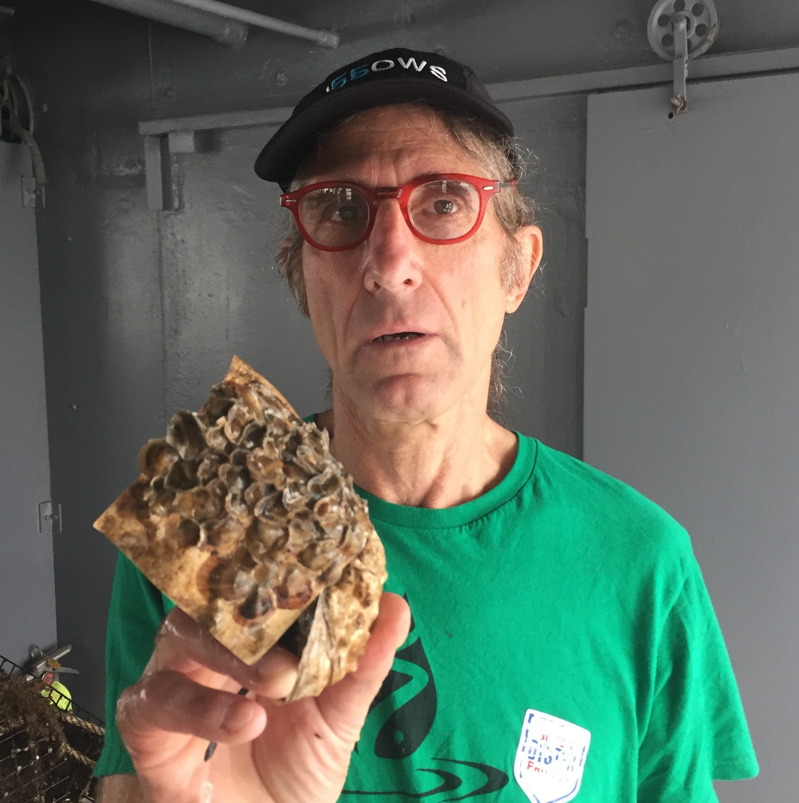
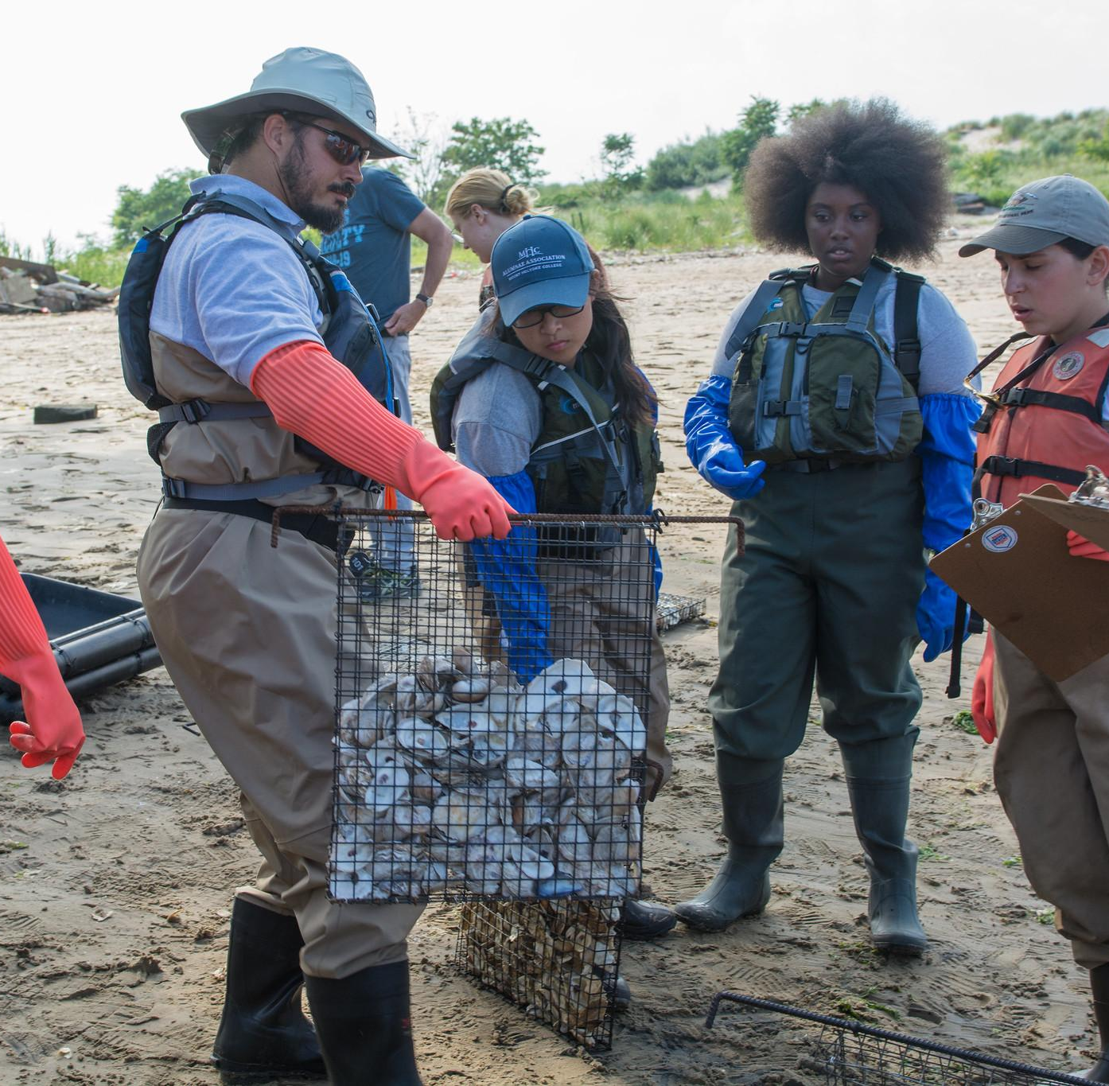
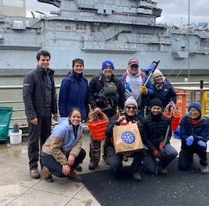
WE HAVE MANY DIFFERENT PARTICIPANT TYPES…
COMMUNITY SCIENTISTS
COMMUNITY BASED ORGANIZATIONS
Community science is public participation and collaboration in scientific research initiatives to increase scientific knowledge.
CBOs adopt ORSs and send us data. They also sometimes support us at our other field stations
ORS AMBASSADOR
TEACHERS AND STUDENTS
Ambassadors will support by monitoring our restoration structures as well as maintenancing them. Additionally providing support at outreach, volunteer, and professional development events.
School groups can adopt ORSs and monitor them. Teachers use them as a classroom tool and bringing students out into the field.
Notes:
Community Scientists:
Community science is public participation and collaboration in scientific research initiatives to increase scientific knowledge.
Through community science, people share and contribute to data monitoring and collection programs.
We use ‘community scientist’ because we don’t want to exclude anyone. Everyone, citizen or not, can participate in community science.
Schools and Teachers
Ambassadors
The Billion Oyster Project Ambassador Program provides an opportunity for public volunteers who are interested in becoming more involved to take the next step. Through training and exclusive opportunities, Ambassadors are able to learn more about each of our programs, apply current skill sets and build skills & experience while supporting our mission and programming.
From physically monitoring our restoration structures and surveying wild oyster populations in the field to providing support at outreach, volunteer, and professional development events happening at our field stations – participation in the Ambassador program offers a few exciting avenues for individuals to contribute to our mission.
They have various areas of interest they could focus on, from to provide outreach at educational and foodie events, help facilitate our citizen science trainings and volunteer days. Within each area of interest you will engage and work alongside communities, students, teachers and individual New Yorkers.

Slide 19
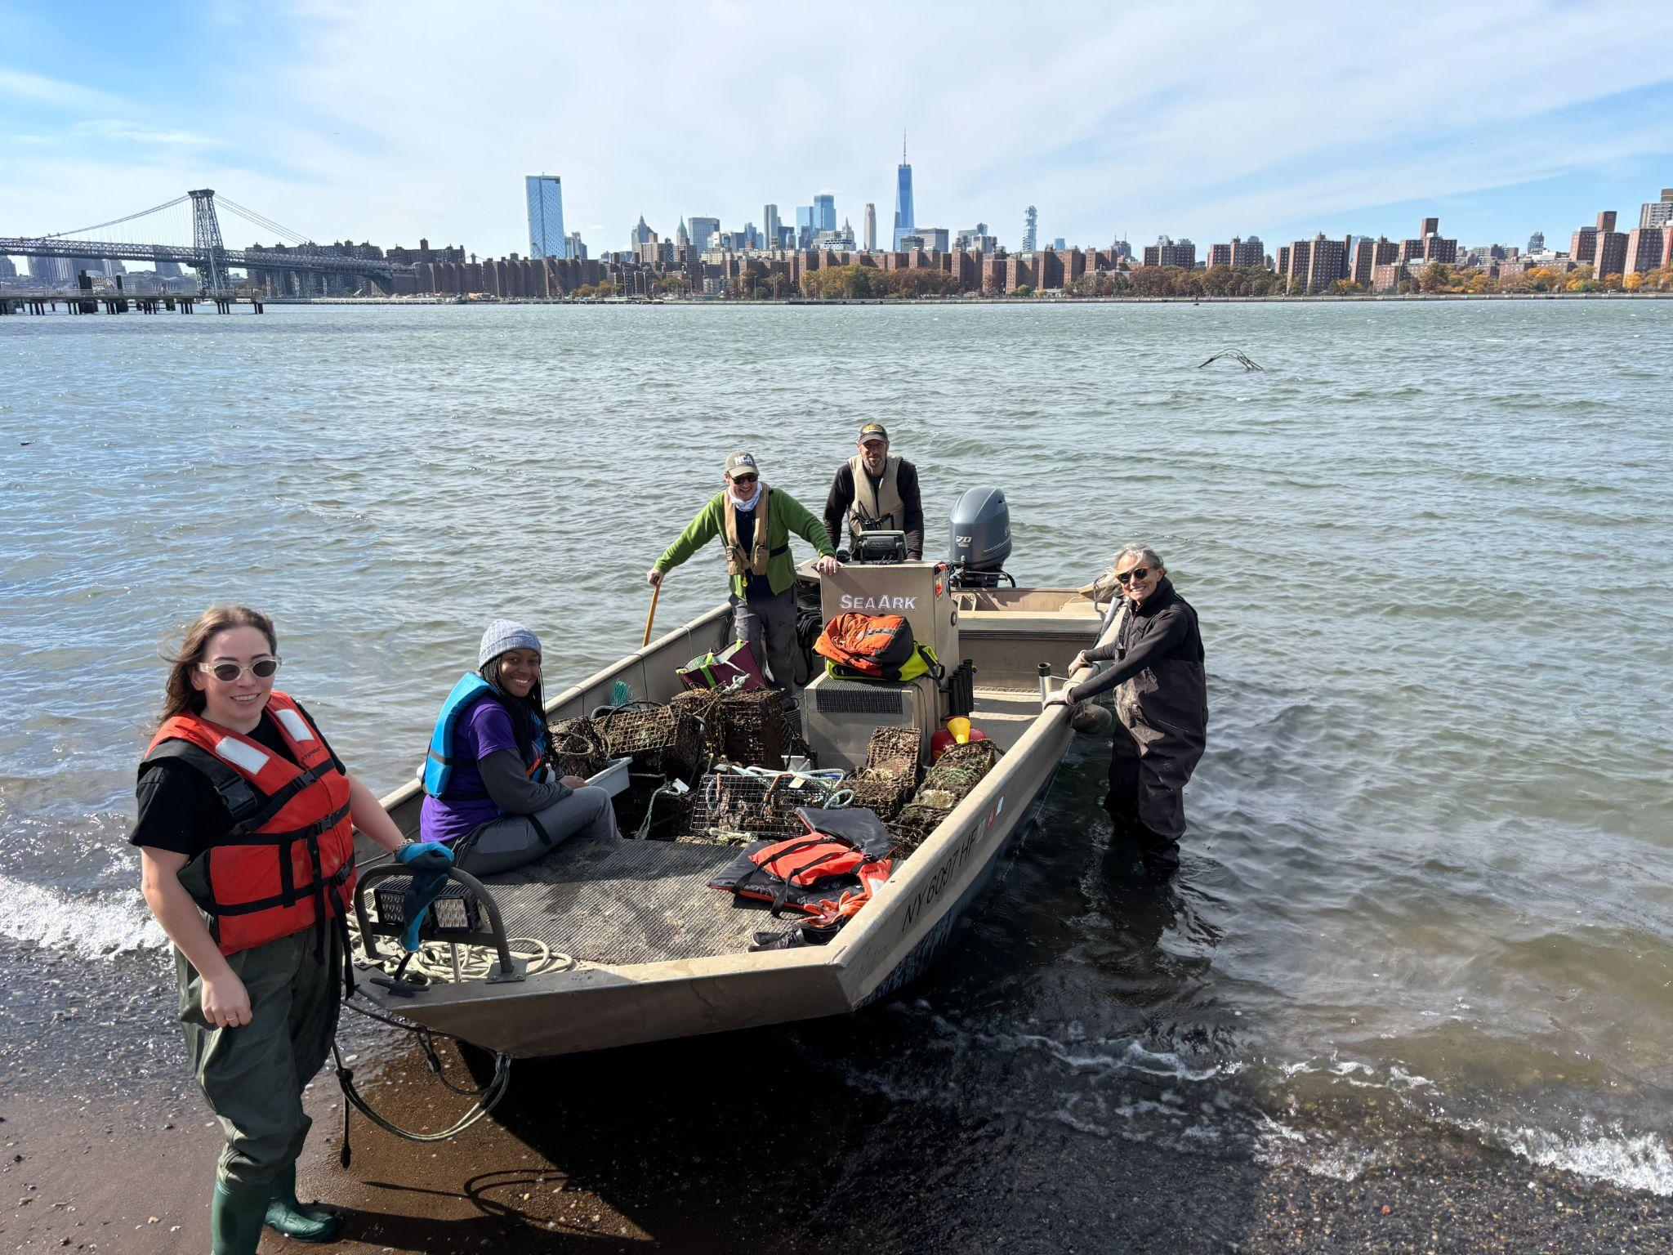
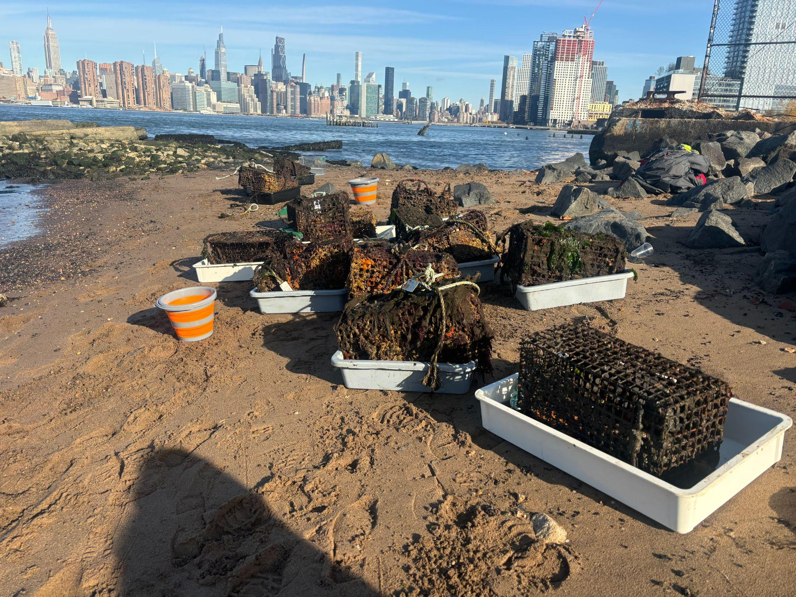
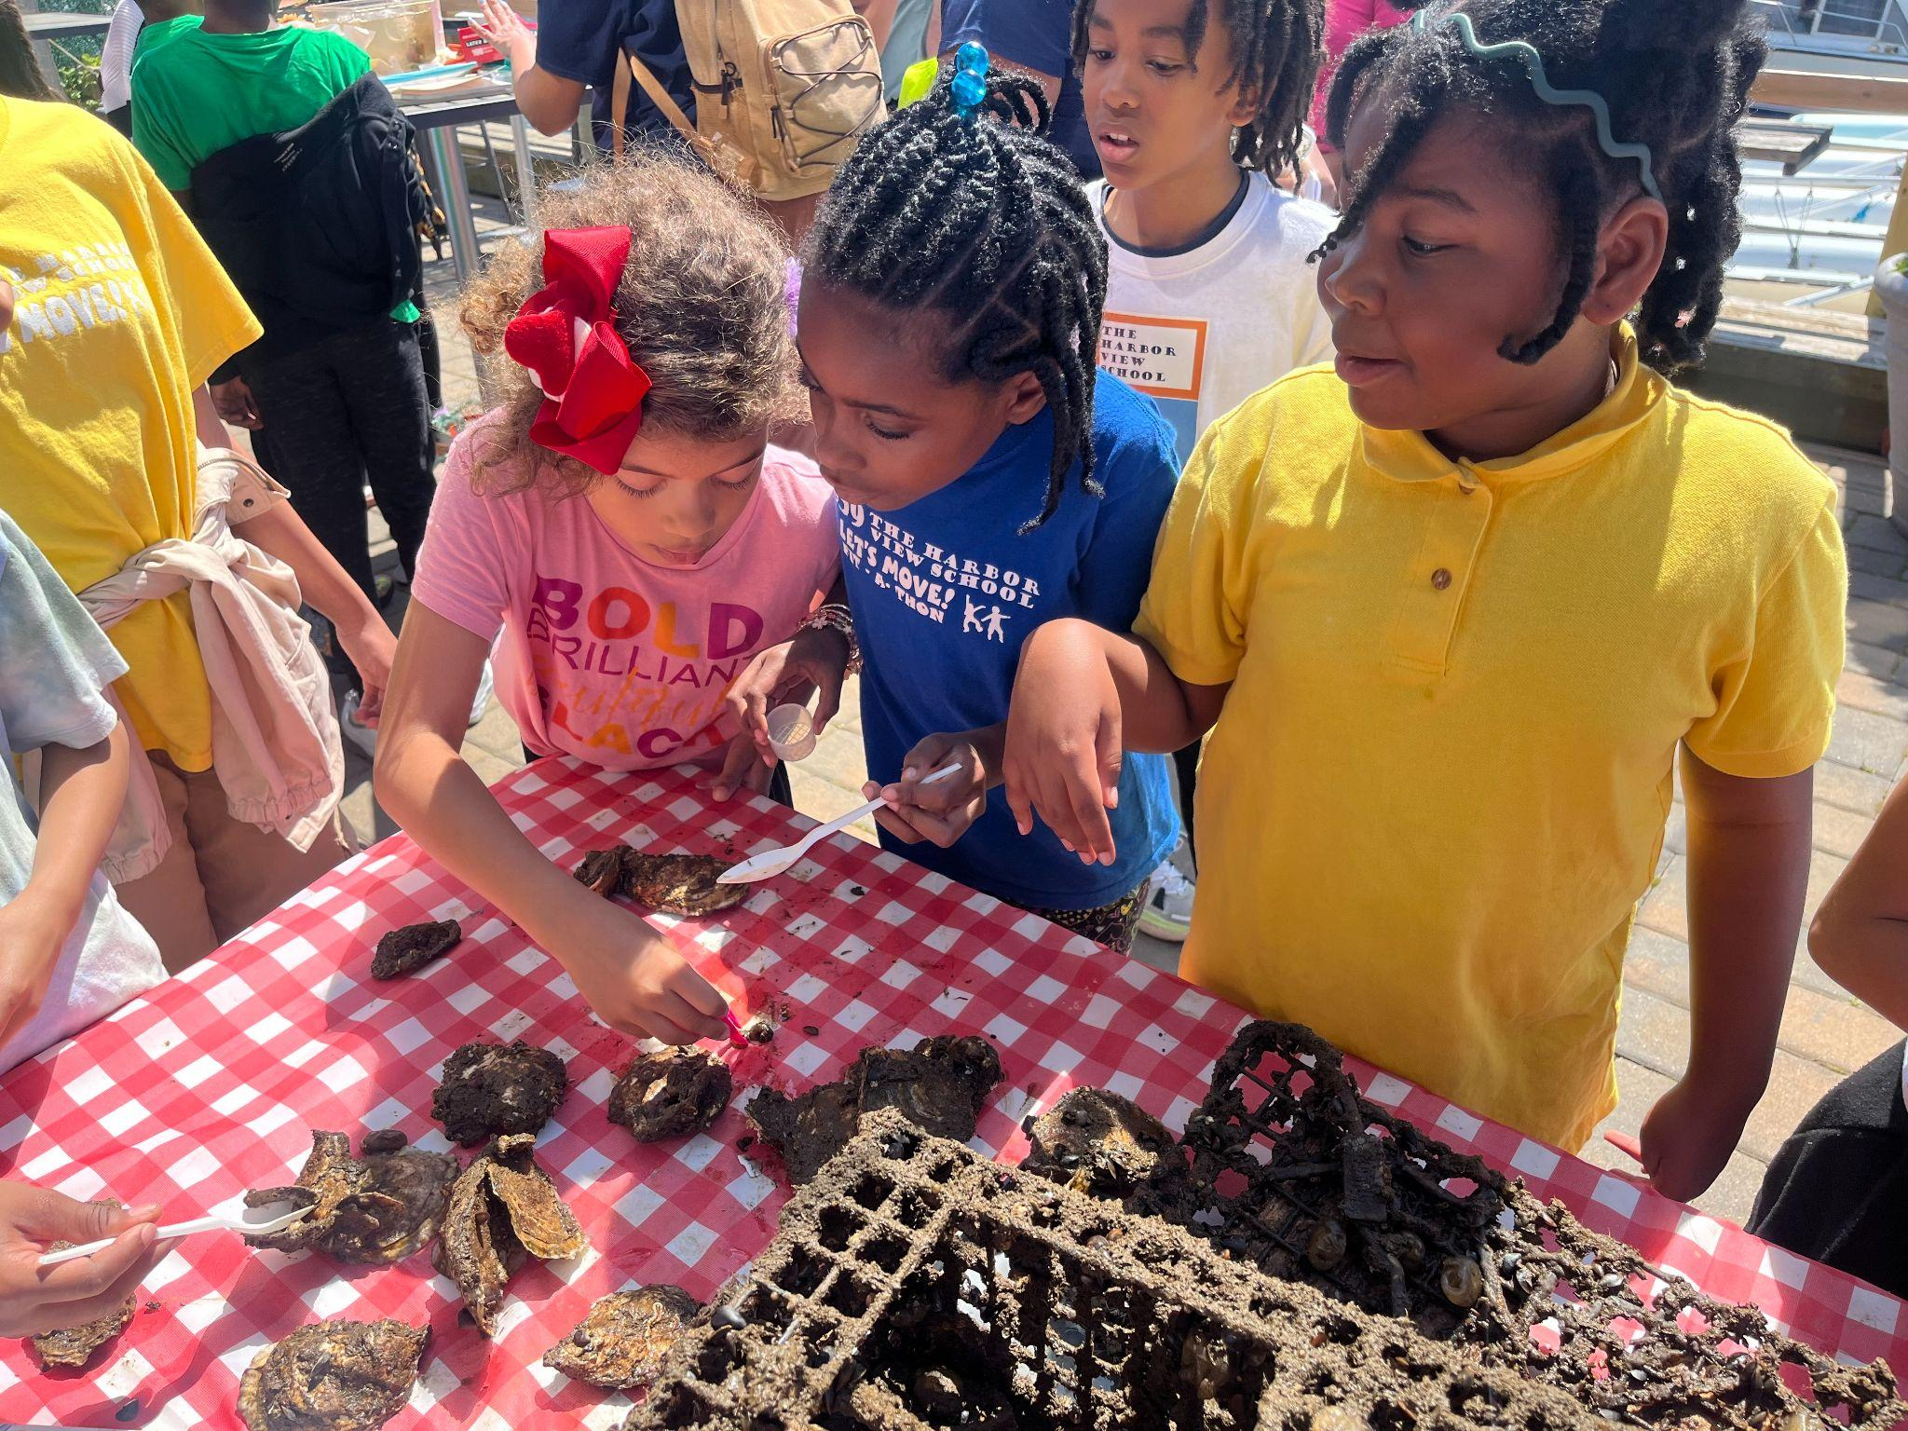
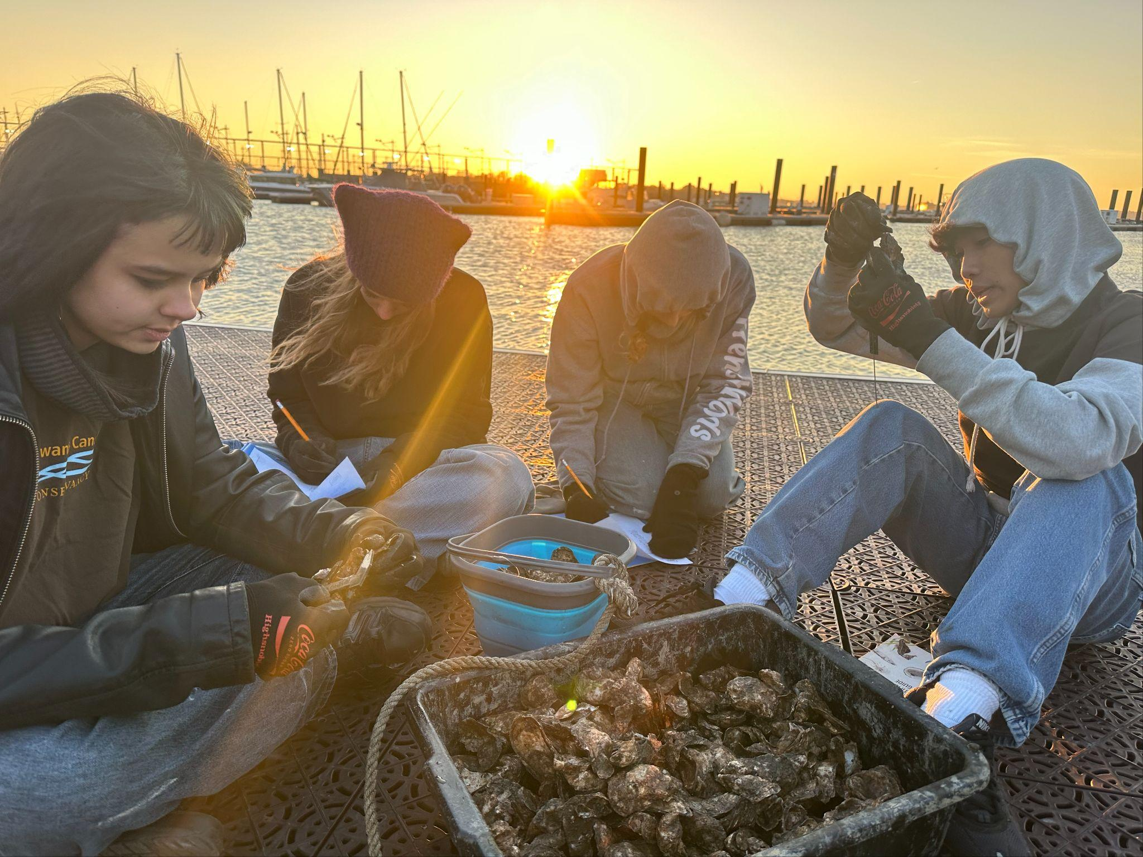
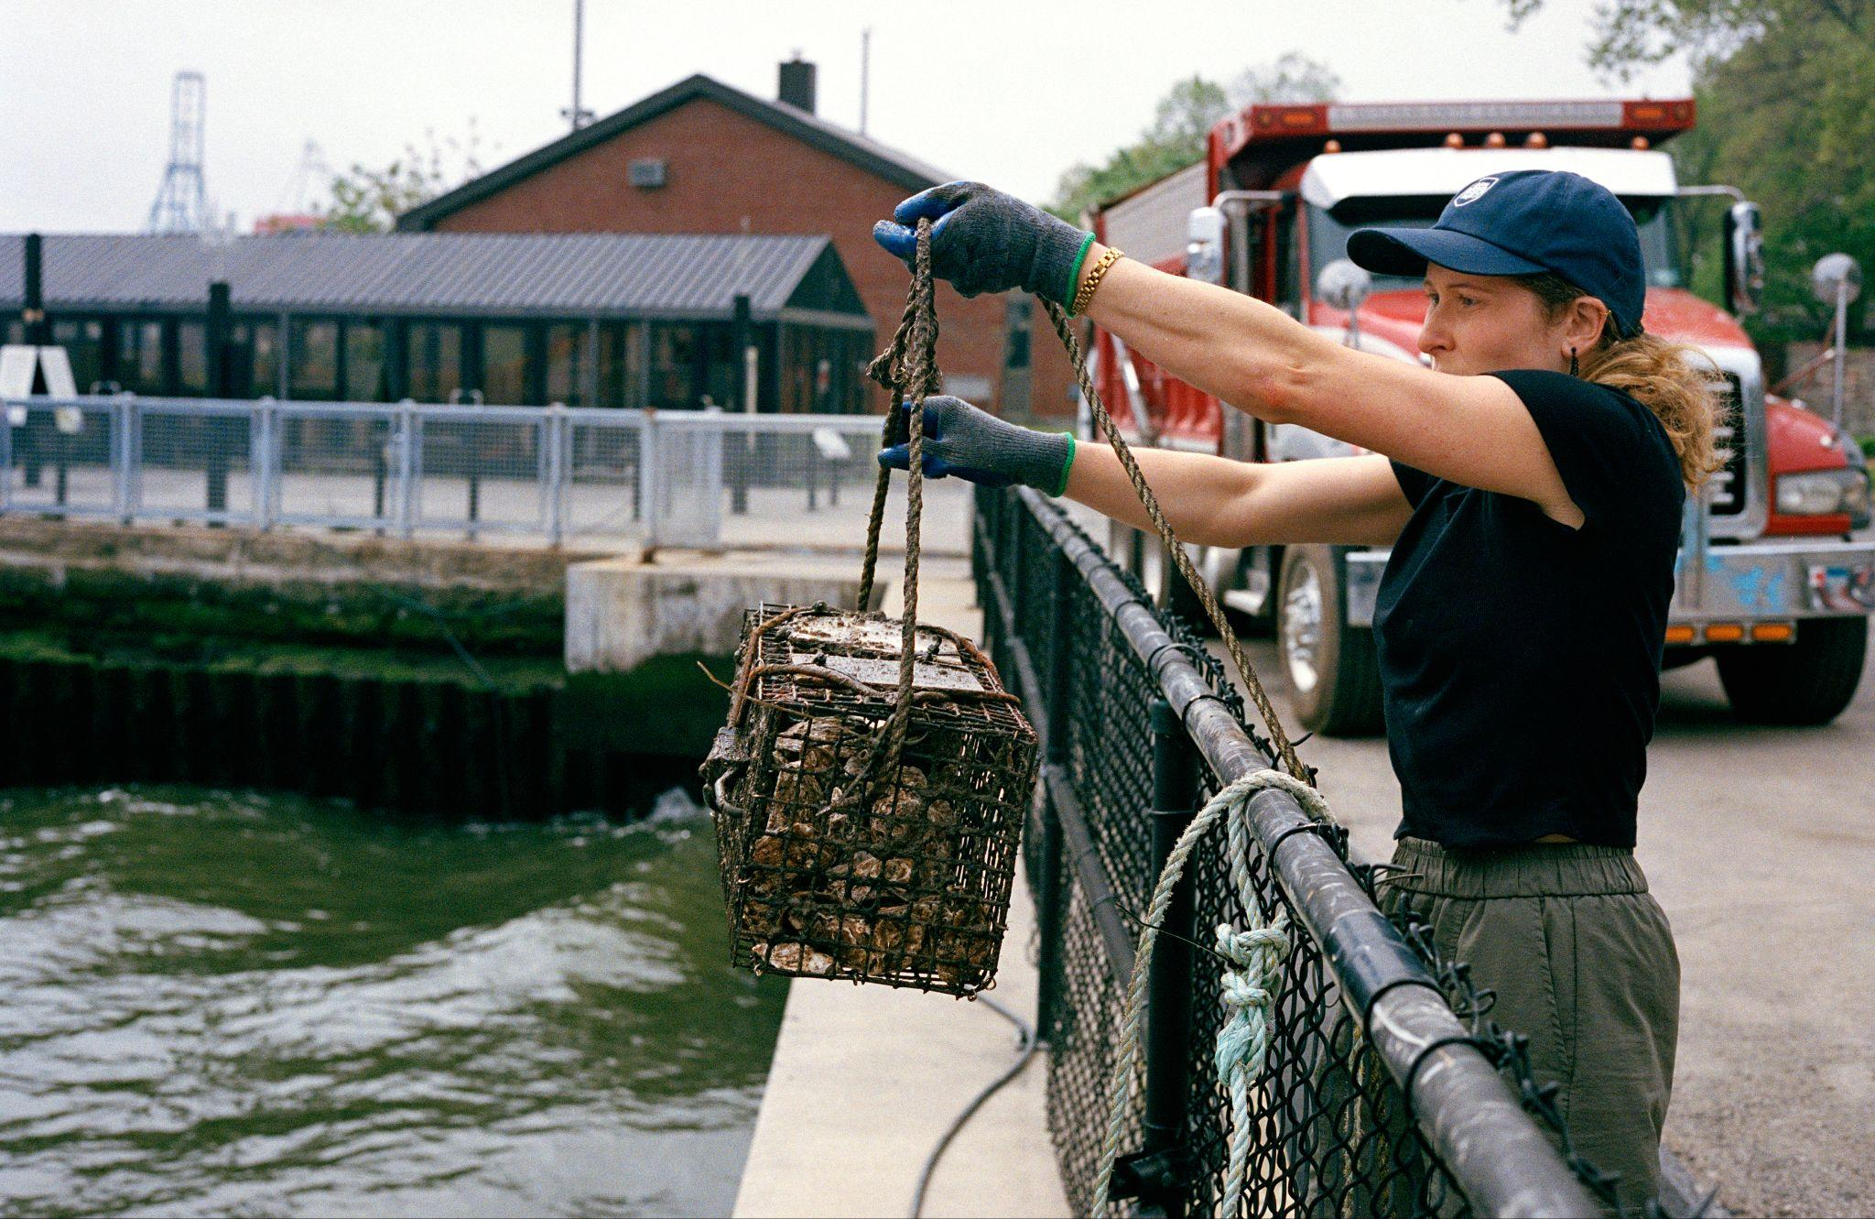
OYSTER RESEARCH STATION MONITORING
Notes:
Protocol: https://docs.google.com/document/d/1YsmhJJATekyTrEdvJeNrGNtKuG0yMCs2IxSatzgKPZk/edit?usp=sharing
Datasheet: https://docs.google.com/document/d/1jOrDZOq7Bvpa2OOFwGr7FyEA_eWvteWQwuOmT8VZaX4/edit?usp=sharing

Slide 20
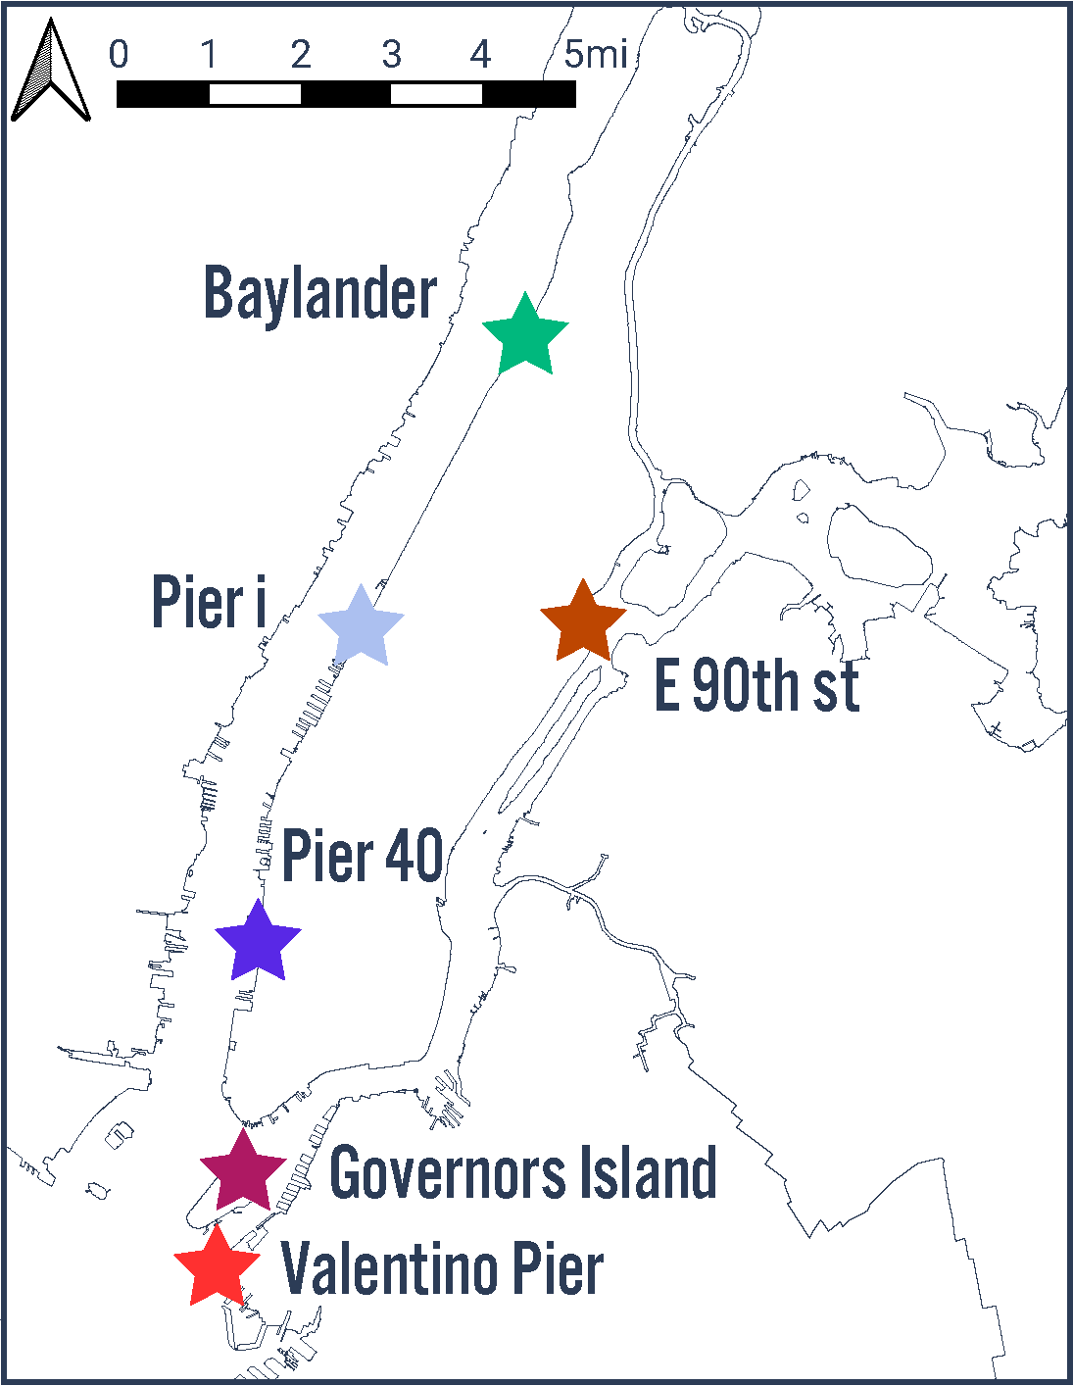
OYSTER RESEARCH STATION MONITORING
Notes:
Protocol: https://docs.google.com/document/d/1YsmhJJATekyTrEdvJeNrGNtKuG0yMCs2IxSatzgKPZk/edit?usp=sharing
Datasheet: https://docs.google.com/document/d/1jOrDZOq7Bvpa2OOFwGr7FyEA_eWvteWQwuOmT8VZaX4/edit?usp=sharing

Slide 21
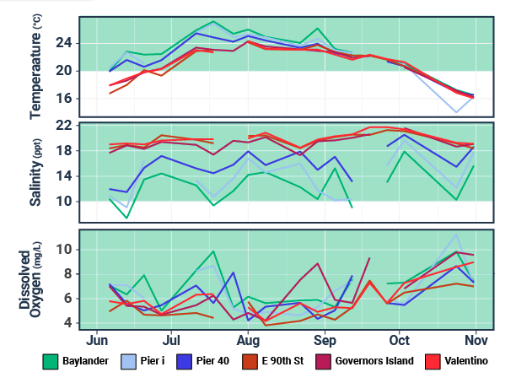
OYSTER RESEARCH STATION MONITORING
Notes:
Protocol: https://docs.google.com/document/d/1YsmhJJATekyTrEdvJeNrGNtKuG0yMCs2IxSatzgKPZk/edit?usp=sharing
Datasheet: https://docs.google.com/document/d/1jOrDZOq7Bvpa2OOFwGr7FyEA_eWvteWQwuOmT8VZaX4/edit?usp=sharing

Slide 22
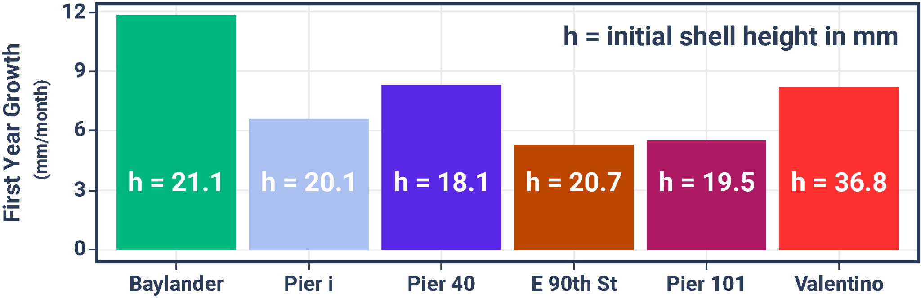
Oyster Growth
Notes:
Protocol: https://docs.google.com/document/d/1YsmhJJATekyTrEdvJeNrGNtKuG0yMCs2IxSatzgKPZk/edit?usp=sharing
Datasheet: https://docs.google.com/document/d/1jOrDZOq7Bvpa2OOFwGr7FyEA_eWvteWQwuOmT8VZaX4/edit?usp=sharing

Slide 23
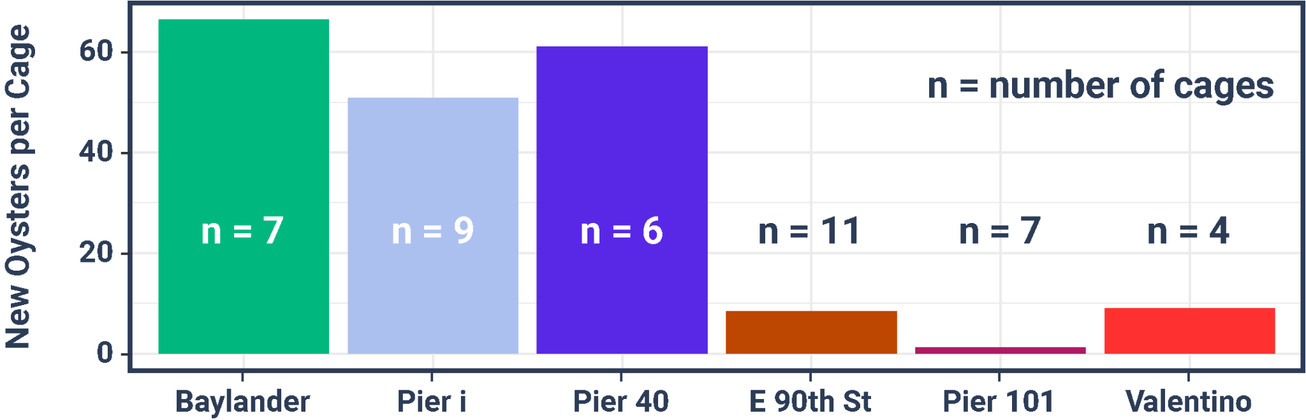
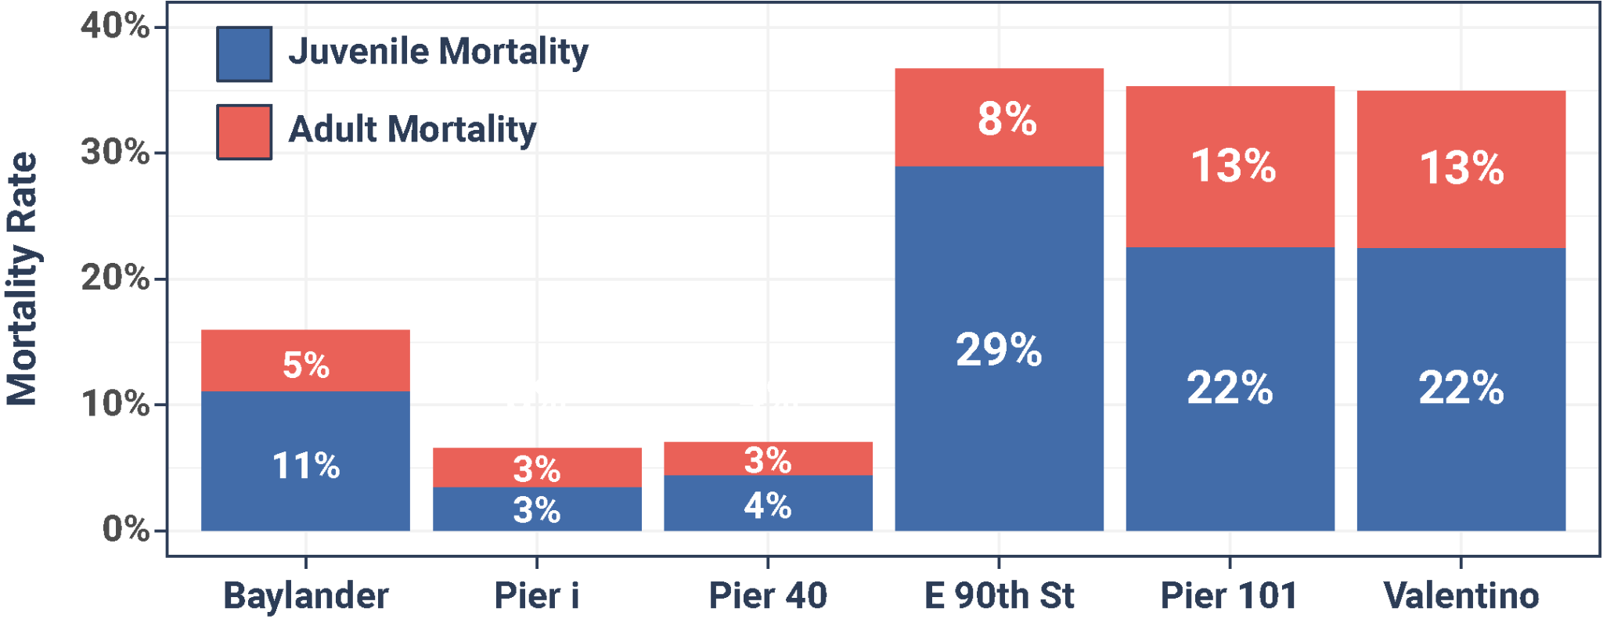
Recruitment and Mortality
Notes:
Protocol: https://docs.google.com/document/d/1YsmhJJATekyTrEdvJeNrGNtKuG0yMCs2IxSatzgKPZk/edit?usp=sharing
Datasheet: https://docs.google.com/document/d/1jOrDZOq7Bvpa2OOFwGr7FyEA_eWvteWQwuOmT8VZaX4/edit?usp=sharing

Slide 24
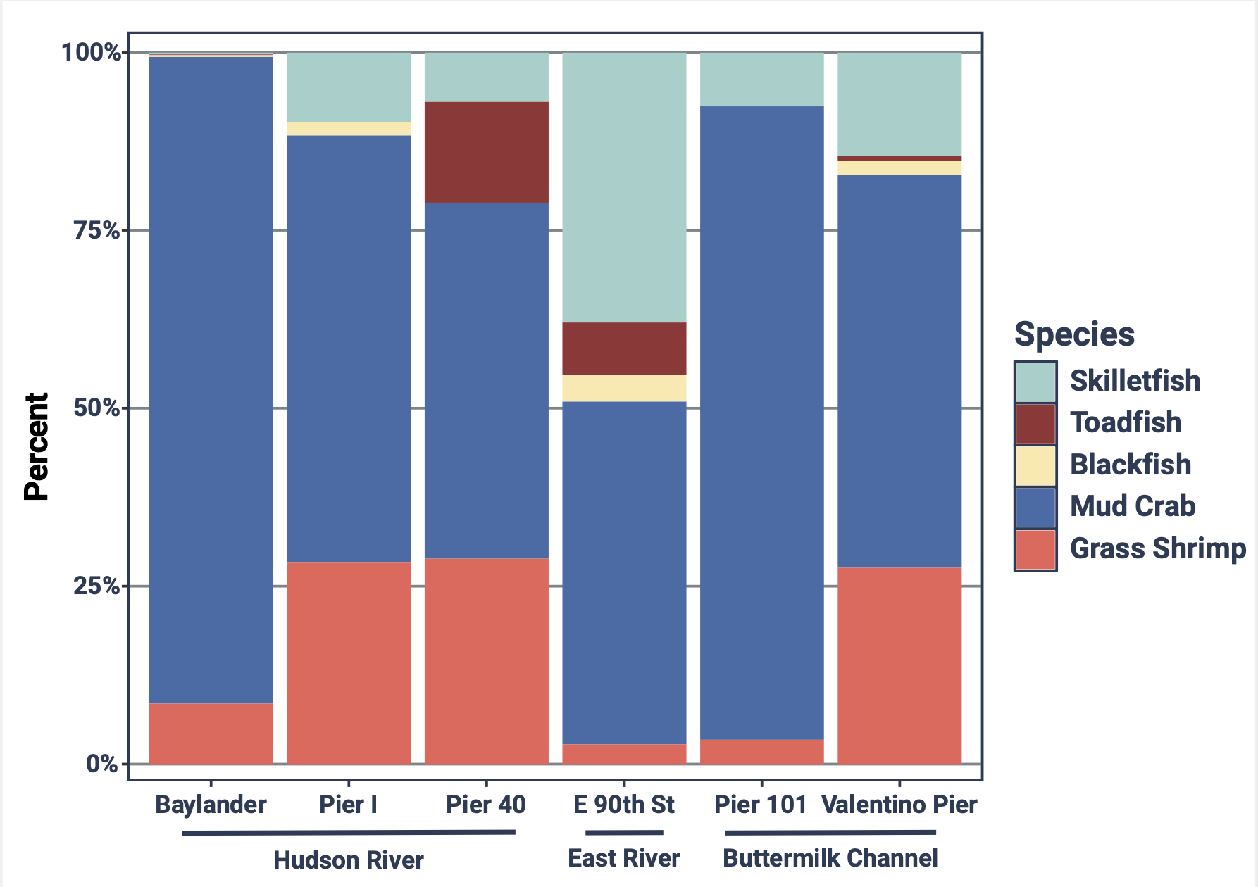
Biodiversity
Notes:
Protocol: https://docs.google.com/document/d/1YsmhJJATekyTrEdvJeNrGNtKuG0yMCs2IxSatzgKPZk/edit?usp=sharing
Datasheet: https://docs.google.com/document/d/1jOrDZOq7Bvpa2OOFwGr7FyEA_eWvteWQwuOmT8VZaX4/edit?usp=sharing

Slide 25
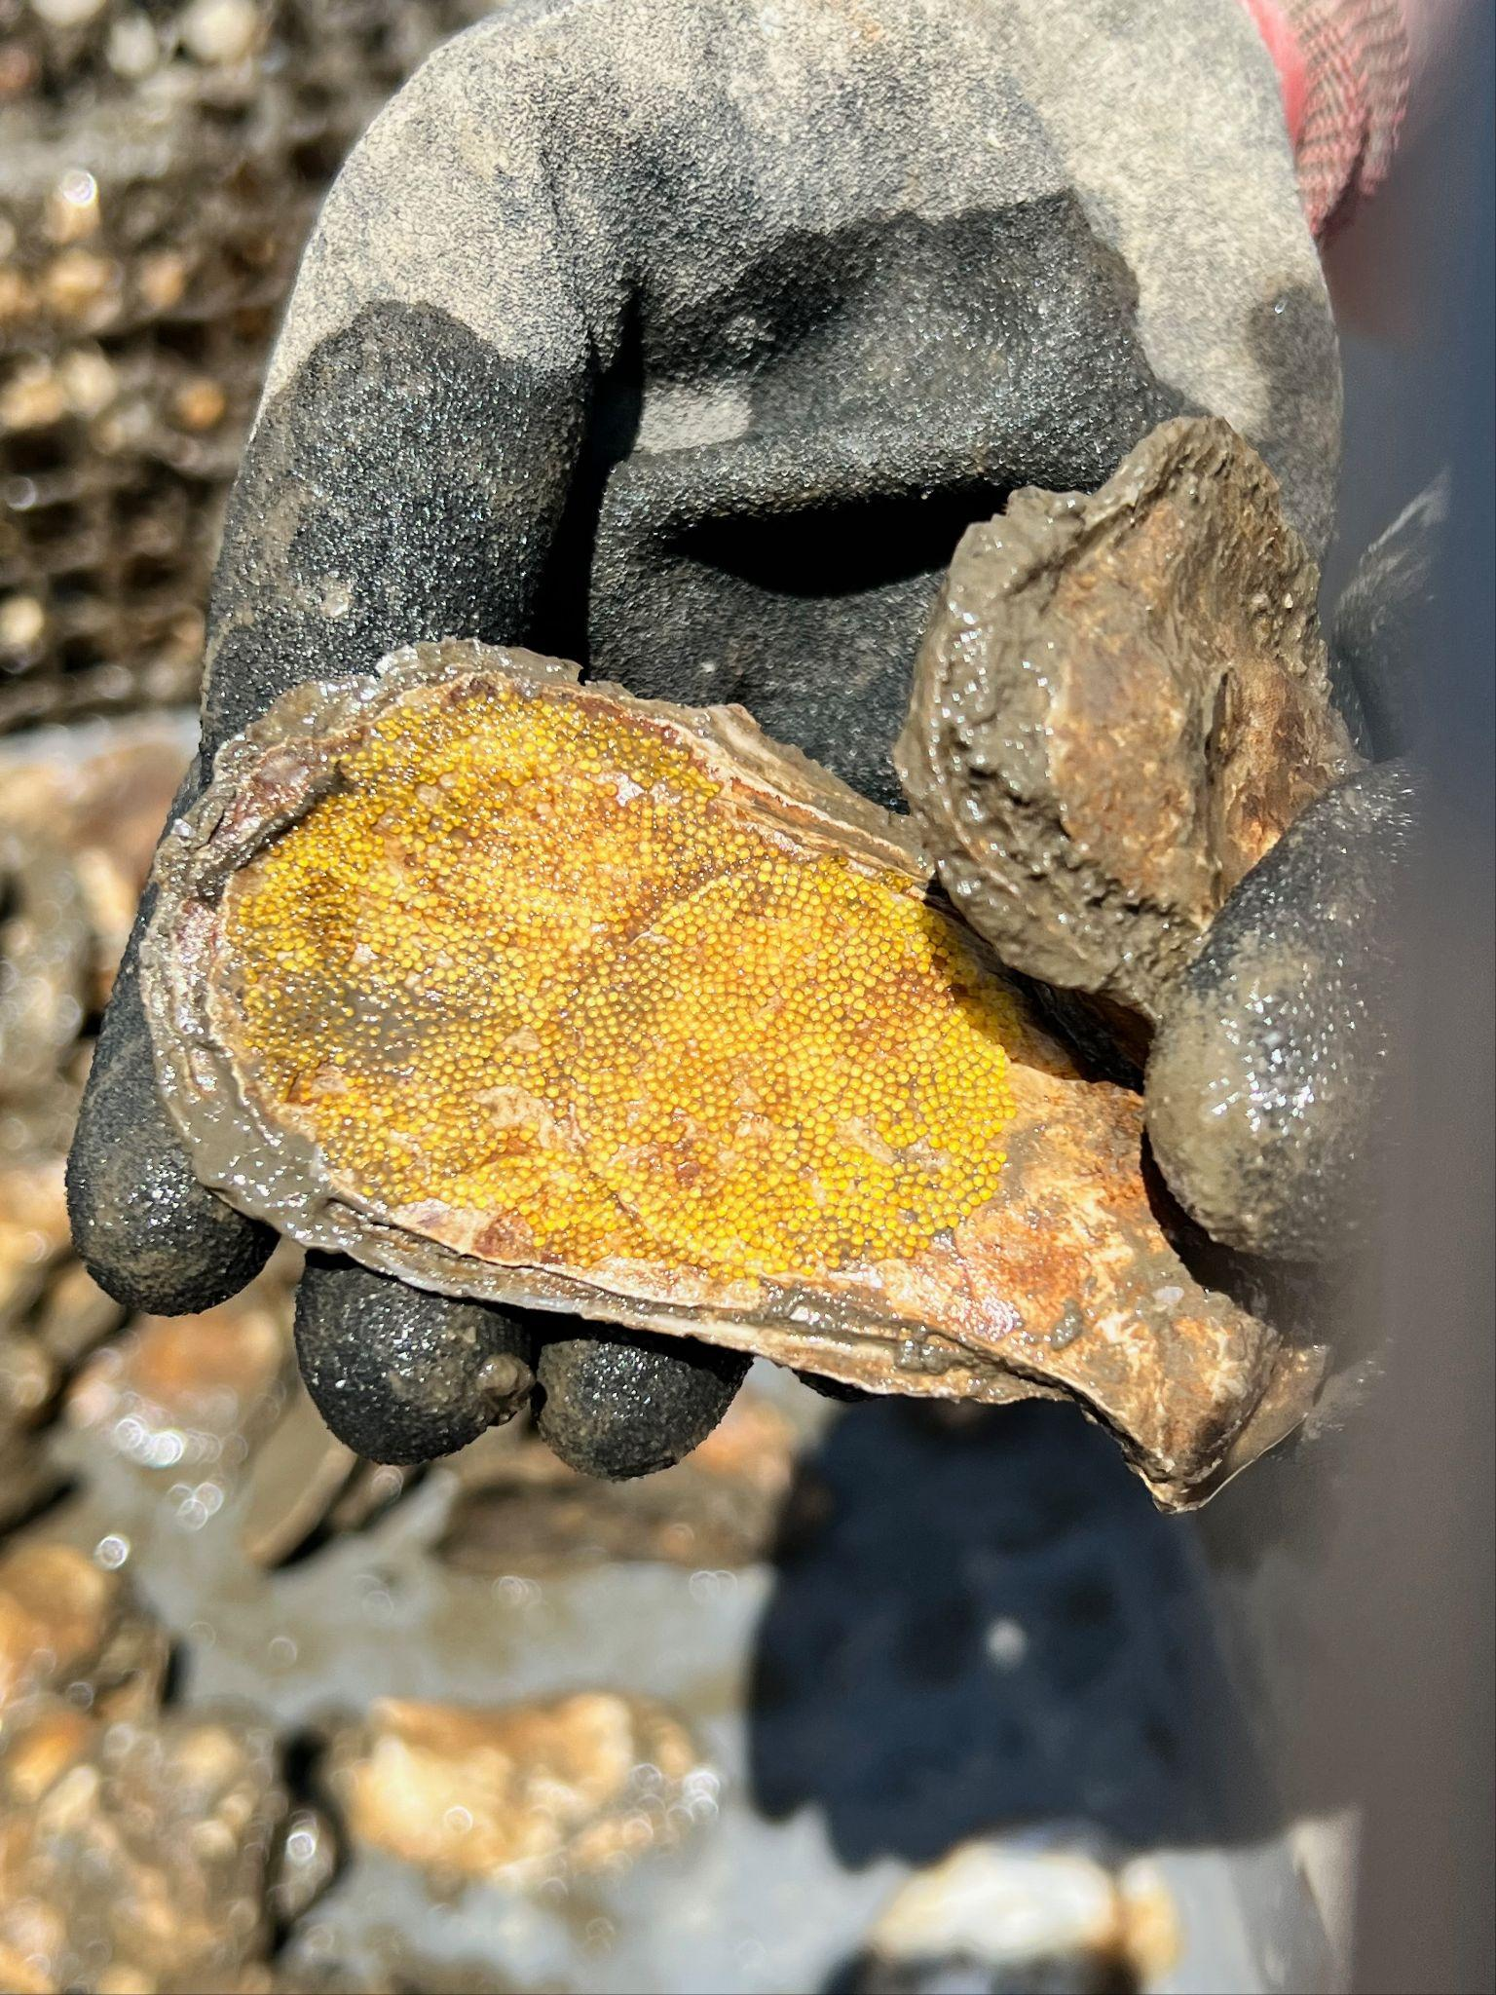
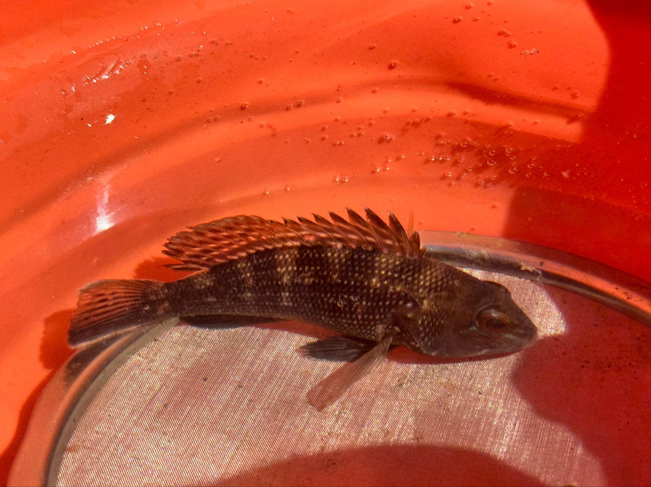




Summary
Impressive first-year growth across all sites
Mortality rates are within the expected range
Amazing recruitment in our Hudson River sites
Together, these findings suggest that restoring a healthy, self-sustaining oysters population to New York Harbor is well within our reach!
Data from the Oyster Research Stations is used to inform our larger restoration efforts.
This information helps us target areas where we know deployed oysters will have the best chance to thrive for future restoration efforts
Notes:
Protocol: https://docs.google.com/document/d/1YsmhJJATekyTrEdvJeNrGNtKuG0yMCs2IxSatzgKPZk/edit?usp=sharing
Datasheet: https://docs.google.com/document/d/1jOrDZOq7Bvpa2OOFwGr7FyEA_eWvteWQwuOmT8VZaX4/edit?usp=sharing

Slide 26
AGENDA
Introductions ✔
Billion Oyster Project Intro ✔
Why Oysters? ✔
Oyster Research Stations ✔
Community Water Quality Testing
Q+A

Slide 27

community
water quality
testing

Slide 28








What is water quality?
DISSOLVED OXYGEN
NUTRIENTS
pH
LITTER/DEBRIS
OIL/PETROLEUM
CHEMICAL WASTE
BACTERIA/ALGAE
TURBIDITY
Notes:
Few people are aware of CSOs and the threat they pose to human beings. Oysters are less susceptible to the effects of CSOs, however, their natural water-filtering capabilities create a major obstacle to oyster reef restoration in New York Harbor — due to regulators’ fears that contaminated oysters will be harvested and consumed.
In the lab, we use a citizen-friendly, EPA-approved testing method called IDEXX Enterolert. The goal is to identify the amount of Enterococcus bacteria in each sample. Enterococcus is the most widely used 'fecal indicator bacteria'. Though not inherently harmful, its presence suggests that of other harmful bacteria and viruses

Slide 29

CWQT only tests for enterococcus
Enterococcus is a family of bacteria that lives in the intestinal tracts of warm-blooded animals
When found in water, it is a fecal indicator which tells you that there is poop in the water
Fecal bacteria can be harmful to human health, and prevent safe primary contact, making activities like swimming and wading more risky
Enterococcus has a higher tolerance to salt water compared to other fecal indicators like e coli
Notes:
Few people are aware of CSOs and the threat they pose to human beings. Oysters are less susceptible to the effects of CSOs, however, their natural water-filtering capabilities create a major obstacle to oyster reef restoration in New York Harbor — due to regulators’ fears that contaminated oysters will be harvested and consumed.
In the lab, we use a citizen-friendly, EPA-approved testing method called IDEXX Enterolert. The goal is to identify the amount of Enterococcus bacteria in each sample. Enterococcus is the most widely used 'fecal indicator bacteria'. Though not inherently harmful, its presence suggests that of other harmful bacteria and viruses

Slide 30

How does enterococcus get into the Harbor? Combined Sewage Overflow
*If you see discharge coming from any of New York City’s 700 combined sewer outfalls (an outfall is an outlet along the waterfront connecting the City’s sewers to the open waters) during dry weather conditions, report it to 311 or file a complaint online. Each outfall has a sign with an identification number. Be sure to give the 311 operator the outfall number.
Notes:
Few people are aware of CSOs and the threat they pose to human beings. Oysters are less susceptible to the effects of CSOs, however, their natural water-filtering capabilities create a major obstacle to oyster reef restoration in New York Harbor — due to regulators’ fears that contaminated oysters will be harvested and consumed.
In the lab, we use a citizen-friendly, EPA-approved testing method called IDEXX Enterolert. The goal is to identify the amount of Enterococcus bacteria in each sample. Enterococcus is the most widely used 'fecal indicator bacteria'. Though not inherently harmful, its presence suggests that of other harmful bacteria and viruses

Slide 31

Quick shout out to geese!
💩
💩
💩
💩
Notes:
Few people are aware of CSOs and the threat they pose to human beings. Oysters are less susceptible to the effects of CSOs, however, their natural water-filtering capabilities create a major obstacle to oyster reef restoration in New York Harbor — due to regulators’ fears that contaminated oysters will be harvested and consumed.
In the lab, we use a citizen-friendly, EPA-approved testing method called IDEXX Enterolert. The goal is to identify the amount of Enterococcus bacteria in each sample. Enterococcus is the most widely used 'fecal indicator bacteria'. Though not inherently harmful, its presence suggests that of other harmful bacteria and viruses

Slide 32


How does enterococcus get into the Harbor? NYC has a wastewater + stormwater problem
NYC’s sewer system pollutes the Harbor!
60-70% of NYC has a Combined Sewage System
Raw sewage and untreated stormwater is expelled through 418 combined sewage overflows (CSOs) when wastewater treatment plants are overloaded during wet weather events
27 billion gallons of CSO discharged into the harbor annually
as little as 1/10th of an inch of rain can trigger CSO in NYC
30-40% of NYC has a Municipal Separate Storm Sewer System (MS4)
Strict regulations allow separate storm sewers that carry untreated stormwater runoff directly to local water bodies during wet weather
Pet waste, litter, heavy metals from fuel emissions, and other debris flow into the Harbor when stormwater drains of roads and other surfaces
~5% Direct Drainage (unpermitted???)
CSO
MS4 STORM DRAIN
Notes:
Few people are aware of CSOs and the threat they pose to human beings. Oysters are less susceptible to the effects of CSOs, however, their natural water-filtering capabilities create a major obstacle to oyster reef restoration in New York Harbor — due to regulators’ fears that contaminated oysters will be harvested and consumed.
In the lab, we use a citizen-friendly, EPA-approved testing method called IDEXX Enterolert. The goal is to identify the amount of Enterococcus bacteria in each sample. Enterococcus is the most widely used 'fecal indicator bacteria'. Though not inherently harmful, its presence suggests that of other harmful bacteria and viruses

Slide 33


What can we do to help mitigate this issue? How can we capture stormwater and waste?
Mitigation of overflow and pollution into the Harbor primarily relies on a combination of:
Upgrades to Wastewater Treatment Facilities, interceptors, pumps, etc.
Detention of stormwater/sewage
(ex. storage tanks and grey infrastructure)
Retention of stormwater
(ex. rain gardens and green infrastructure)
GRAY INFRASTRUCTURE
GREEN INFRASTRUCTURE
Notes:
Few people are aware of CSOs and the threat they pose to human beings. Oysters are less susceptible to the effects of CSOs, however, their natural water-filtering capabilities create a major obstacle to oyster reef restoration in New York Harbor — due to regulators’ fears that contaminated oysters will be harvested and consumed.
In the lab, we use a citizen-friendly, EPA-approved testing method called IDEXX Enterolert. The goal is to identify the amount of Enterococcus bacteria in each sample. Enterococcus is the most widely used 'fecal indicator bacteria'. Though not inherently harmful, its presence suggests that of other harmful bacteria and viruses

Slide 34

Notes:
Few people are aware of CSOs and the threat they pose to human beings. Oysters are less susceptible to the effects of CSOs, however, their natural water-filtering capabilities create a major obstacle to oyster reef restoration in New York Harbor — due to regulators’ fears that contaminated oysters will be harvested and consumed.
In the lab, we use a citizen-friendly, EPA-approved testing method called IDEXX Enterolert. The goal is to identify the amount of Enterococcus bacteria in each sample. Enterococcus is the most widely used 'fecal indicator bacteria'. Though not inherently harmful, its presence suggests that of other harmful bacteria and viruses

Slide 35

What impacts water quality in NYC?
What is CWQT? Why do we do this, and what are we doing?
Started in 2012 by NYC Water Trails Association – 2024 was our 13th season! Focused on testing for bacteria near public access points on shoreline edge
Over 10,000 samples collected from 140 locations, proceed by 17 partner labs
Fills in data gaps left by City, State and Federal agencies
Historically has compared entero. data to NYC Dept of Health standard for swimming
Thursday mornings for 20 consecutive weeks during recreational boating season, samples are collected by community scientists, students, paddlers, and partner organization staff, to measure weekly enterococcus data
Notes:
Few people are aware of CSOs and the threat they pose to human beings. Oysters are less susceptible to the effects of CSOs, however, their natural water-filtering capabilities create a major obstacle to oyster reef restoration in New York Harbor — due to regulators’ fears that contaminated oysters will be harvested and consumed.
In the lab, we use a citizen-friendly, EPA-approved testing method called IDEXX Enterolert. The goal is to identify the amount of Enterococcus bacteria in each sample. Enterococcus is the most widely used 'fecal indicator bacteria'. Though not inherently harmful, its presence suggests that of other harmful bacteria and viruses

Slide 36

What we do, when we do it + why:
Thursday morning entero. samples →
Thursday afternoon lab processing →
***24hrs in the incubator*** Friday afternoon entero. results →
Friday evening newsletter →
Weekend recreation with the latest possible results!
Notes:
Few people are aware of CSOs and the threat they pose to human beings. Oysters are less susceptible to the effects of CSOs, however, their natural water-filtering capabilities create a major obstacle to oyster reef restoration in New York Harbor — due to regulators’ fears that contaminated oysters will be harvested and consumed.
In the lab, we use a citizen-friendly, EPA-approved testing method called IDEXX Enterolert. The goal is to identify the amount of Enterococcus bacteria in each sample. Enterococcus is the most widely used 'fecal indicator bacteria'. Though not inherently harmful, its presence suggests that of other harmful bacteria and viruses

Slide 37












CWQT Partner Organizations
Notes:
Few people are aware of CSOs and the threat they pose to human beings. Oysters are less susceptible to the effects of CSOs, however, their natural water-filtering capabilities create a major obstacle to oyster reef restoration in New York Harbor — due to regulators’ fears that contaminated oysters will be harvested and consumed.
In the lab, we use a citizen-friendly, EPA-approved testing method called IDEXX Enterolert. The goal is to identify the amount of Enterococcus bacteria in each sample. Enterococcus is the most widely used 'fecal indicator bacteria'. Though not inherently harmful, its presence suggests that of other harmful bacteria and viruses

Slide 38






In the lab, we use the IDEXX enteroalert system, an EPA-approved testing method. The amount of Enterococcus bacteria in each sample is determined by counting the number of UV reactive wells after 24 hours of incubation.
SAMPLE COLLECTION
SAMPLE DROP OFF
SAMPLE PROCESSING
24 hours later...
Notes:
We test for Enterococcus. “Entero” is commonly found in the fecal matter of warm blooded organisms. The presence of Enterococci in the water is an indicator of fecal pollution as well as the possible presence of pathogens which can be harmful to human health.
METHODOLOGIES - IDEXX
Volunteers take a 100mL sample at their site on Thursday mornings. Then they deliver it to 1 of the 9 different CWQT Partner labs.
Lab techs will feed the sample with an Enterolert reagent.
The sample is then is transferred to a Quanti-Tray. This tray has 48 large wells and 49 small wells. The tray is sealed and placed in an incubator for 24-28 hours at a temperature of 41±0.5°C
While in the incubator the bacteria will metabolize the reagent. When enterococci use their ß-glucosidase enzyme to metabolize this Enterolert’s nutrient-indicator (4-methyl-umbelliferyl ß-D-glucoside) the sample will become fluorescent under UV light.
After 24-28 hours, the samples are removed from the incubator. The wells are counted and an estimation of the most probable number (MPN) is made for how much Enterococcus was present at the sample site.

Slide 39

What impacts water quality in NYC?
How can we use CWQT data?
The CWQT program provides access to water quality data that informs boaters, swimmers, and other water users when and where it’s safe to explore and enjoy their local waterways
CWQT data can be paired with rainfall and tide information to make informed decisions about water quality and its potential impact on human health throughout the NY - NJ Estuary
Using NYC Dept Health enterococcus standards for primary contact, like swimming, we color code results our results
Data can also be compared to State and Federal standards as needed
Notes:
Few people are aware of CSOs and the threat they pose to human beings. Oysters are less susceptible to the effects of CSOs, however, their natural water-filtering capabilities create a major obstacle to oyster reef restoration in New York Harbor — due to regulators’ fears that contaminated oysters will be harvested and consumed.
In the lab, we use a citizen-friendly, EPA-approved testing method called IDEXX Enterolert. The goal is to identify the amount of Enterococcus bacteria in each sample. Enterococcus is the most widely used 'fecal indicator bacteria'. Though not inherently harmful, its presence suggests that of other harmful bacteria and viruses

Slide 40


CWQT Site Map
Data sheets for each current and past site that include all years sampled
Location of current and past CWQT labs
Site photos
Updated before and after each CWQT season
CWQT Data Sheets
Datasheets show entero. concentrations, sample time, rainfall numbers for Central Park and Battery high tide by sample season
Each sheet includes tabs with historic data from previous years
Notes:
We test for Enterococcus. “Entero” is commonly found in the fecal matter of warm blooded organisms. The presence of Enterococci in the water is an indicator of fecal pollution as well as the possible presence of pathogens which can be harmful to human health.
METHODOLOGIES - IDEXX
Volunteers take a 100mL sample at their site on Thursday mornings. Then they deliver it to 1 of the 9 different CWQT Partner labs.
Lab techs will feed the sample with an Enterolert reagent.
The sample is then is transferred to a Quanti-Tray. This tray has 48 large wells and 49 small wells. The tray is sealed and placed in an incubator for 24-28 hours at a temperature of 41±0.5°C
While in the incubator the bacteria will metabolize the reagent. When enterococci use their ß-glucosidase enzyme to metabolize this Enterolert’s nutrient-indicator (4-methyl-umbelliferyl ß-D-glucoside) the sample will become fluorescent under UV light.
After 24-28 hours, the samples are removed from the incubator. The wells are counted and an estimation of the most probable number (MPN) is made for how much Enterococcus was present at the sample site.

Slide 41


Notes:
We test for Enterococcus. “Entero” is commonly found in the fecal matter of warm blooded organisms. The presence of Enterococci in the water is an indicator of fecal pollution as well as the possible presence of pathogens which can be harmful to human health.
METHODOLOGIES - IDEXX
Volunteers take a 100mL sample at their site on Thursday mornings. Then they deliver it to 1 of the 9 different CWQT Partner labs.
Lab techs will feed the sample with an Enterolert reagent.
The sample is then is transferred to a Quanti-Tray. This tray has 48 large wells and 49 small wells. The tray is sealed and placed in an incubator for 24-28 hours at a temperature of 41±0.5°C
While in the incubator the bacteria will metabolize the reagent. When enterococci use their ß-glucosidase enzyme to metabolize this Enterolert’s nutrient-indicator (4-methyl-umbelliferyl ß-D-glucoside) the sample will become fluorescent under UV light.
After 24-28 hours, the samples are removed from the incubator. The wells are counted and an estimation of the most probable number (MPN) is made for how much Enterococcus was present at the sample site.

Slide 42

Notes:
We test for Enterococcus. “Entero” is commonly found in the fecal matter of warm blooded organisms. The presence of Enterococci in the water is an indicator of fecal pollution as well as the possible presence of pathogens which can be harmful to human health.
METHODOLOGIES - IDEXX
Volunteers take a 100mL sample at their site on Thursday mornings. Then they deliver it to 1 of the 9 different CWQT Partner labs.
Lab techs will feed the sample with an Enterolert reagent.
The sample is then is transferred to a Quanti-Tray. This tray has 48 large wells and 49 small wells. The tray is sealed and placed in an incubator for 24-28 hours at a temperature of 41±0.5°C
While in the incubator the bacteria will metabolize the reagent. When enterococci use their ß-glucosidase enzyme to metabolize this Enterolert’s nutrient-indicator (4-methyl-umbelliferyl ß-D-glucoside) the sample will become fluorescent under UV light.
After 24-28 hours, the samples are removed from the incubator. The wells are counted and an estimation of the most probable number (MPN) is made for how much Enterococcus was present at the sample site.

Slide 43
2024
Geometric
Means
(MPN)
Sampling Sites | Year to Date
Raritan Bay, Midland Beach | 10.00
Raritan Bay, Great Kills Beach | 14.14
Raritan Bay, New Dorp Beach | 14.14
Raritan Bay, Oakwood Beach | 14.14
Hudson River, Pier 40 | 21.90
Hudson River, Pier 26 | 26.19
Hudson River, JFK Marina | 26.97
Upper Harbor, Pier 69 | 27.58
Buttermilk Channel, Valentino Pier | 30.14
Raritan Bay, Waterfront Park, South Amboy, NJ | 30.16
Kill Van Kull, Brady’s Dock, Bayonne NJ | 30.80
Hudson River, Pier 84 | 31.62
Arthur Kill, Conference House Park | 32.41
Hudson River, Gansevoort Peninsula, North | 32.57
Hackensack River, Bayonne City Park, Bayonne NJ | 33.93
Buttermilk Channel, Pier 101, Governors Island | 34.40
Sampling Sites | Year to Date
Hudson River, Pier 96 | 36.01
East River, SUNY Maritime Waterfront Center (MAR) | 36.05
East River, SUNY Maritime Campus Entrance (IT) | 36.11
East River, Pier 2 Kayak Dock, Brooklyn Bridge Park | 41.26
Kissena Lake | 41.57
Hudson River, Pier 13, Hoboken, NJ | 42.53
Hudson River, Gansevoort Peninsula, South | 42.57
East River, Pier 4 Beach, Brooklyn Bridge Park | 46.06
Hudson River, Weehawken Cove, Hoboken NJ | 46.86
Hudson River, Pier 66 | 47.07
Rahway River, Carteret Waterfront Park | 54.94
Little Neck Bay | 55.17
Upper Harbor, Bush Terminal Park (North Embayment) | 58.85
East River, E 90th St Ferry | 62.92
East River, Gantry State Park | 63.24
Gravesend Bay, Calvert Vaux Cove | 67.76
Hackensack River, Rutkowski Park, Bayonne NJ | 68.26
Hudson River, West 172nd Street, Riverside Park | 70.28
Gravesend Bay, OH-015 | 81.84
East River, Stuy Cove Park | 86.25
East River, Bushwick Inlet | 87.46
Harlem River, Lincoln Avenue 2 | 88.63
East River, Hammond Creek (HC) | 88.95
East River, Hallets Cove | 89.16
East River, Grand Ferry Park | 89.66
Upper Harbor, Bush Terminal Park (Inner Lagoon) | 91.66
East River, Dumbo Cove | 95.50
Hudson River, Yonkers Paddling and Rowing Club | 98.79
Hackensack River, Laurel Hill Park, Secaucus NJ | 99.34
Sampling Sites | Year to Date
Hudson River, Pier 99 Boat Launch | 104.53
Raritan River, Ken Buchanan Park, Sayreville NJ | 107.24
East River, Esplanade (+Pool) | 109.97
East River, South 5th Street/Domino Park | 114.03
Bronx River, Soundview Park (mouth) | 121.92
Harlem River, Water's Edge Garden Beach | 128.37
Hudson River, Frank Sinatra Park, Hoboken NJ | 130.24
Bronx Kill, west end | 134.72
Bronx Kill, east end | 140.36
East River, India Street | 140.82
Flushing Bay, 28th Avenue, Big Rock Beach | 148.27
East River, Marsha P Johnson State Park | 149.18
Harlem River, Little Hell Gate | 163.28
Raritan River, Edison Boat Basin, Edison NJ | 166.19
East River, South 8th St | 167.81
East River, Brooklyn Bridge Beach, Manhattan | 170.95
East River, Wallabout Channel, Brooklyn Navy Yard | 186.52
East River, North 3rd Street | 196.42
Hudson River, Hoboken Cove Beach, Hoboken NJ | 205.75
Jamaica Bay, Paerdegat Basin, Sebago Canoe Club | 241.22
Raritan River, Rutgers Boathouse, New Brunswick NJ | 266.53
East River, Bushwick Inlet Park Beach | 268.89
Coney Island Creek, Kaiser Park | 269.34
East River, WNYC Transmitter Park | 272.25
Gowanus Canal, Lowlands Nursery | 331.24
Flushing Bay, World's Fair Marina Pier 1 East | 338.93
Newtown Creek, Apollo Street | 412.68
Meadow Lake, Flushing Meadows-Corona Park | 455.29
Newtown Creek, Pulaski Bridge, Queens | 488.62
Newtown Creek, Second Street Kayak Launch | 526.06
Gowanus Canal, Second Street Sponge Park | 539.17
Hackensack River, River Barge Park, Carlstadt NJ | 570.14
Flushing Bay, World's Fair Marina Boat Ramp | 603.38
Bronx River, Soundview Park, HP009 CSO | 666.59
Bronx River, Concrete Plant Park Canoe Launch | 746.97
Newtown Creek, East Branch | 748.63
Rahway River, Rahway Valley Sewerage Authority | 789.06
Bronx River, Hunts Point Riverside Park | 932.75
Hackensack River, Ridgefield Park, NJ | 984.87
Flushing Creek | 1048.35
Rahway River, Riverfront Park | 1078.66
Raritan River, Riverside Park, Piscataway NJ | 1109.94
Bronx River, Starlight Park, North Dock | 1120.66
Saw Mill River, daylighted section | 1321.00
Newtown Creek, English Kills | 1590.32
Prospect Park Lake | 1665.77
Newtown Creek, Dutch Kills (head) | 1886.59
Raritan River, Second Street Park, Perth Amboy NJ | 2876.48
Despite less rain than previous years, 2024 entero. results were worse than 2023’s
Areas in open water with strong current tend to have less bacteria, while narrow tributaries with limited current and tidal flushing tendy to have higher bacterial levels
In 2024 the cleanest site in NYC was Pier 40 on the Hudson River, and the dirtiest was Dutch Kills in Newtown Creek, Queens
Notes:
We test for Enterococcus. “Entero” is commonly found in the fecal matter of warm blooded organisms. The presence of Enterococci in the water is an indicator of fecal pollution as well as the possible presence of pathogens which can be harmful to human health.
METHODOLOGIES - IDEXX
Volunteers take a 100mL sample at their site on Thursday mornings. Then they deliver it to 1 of the 9 different CWQT Partner labs.
Lab techs will feed the sample with an Enterolert reagent.
The sample is then is transferred to a Quanti-Tray. This tray has 48 large wells and 49 small wells. The tray is sealed and placed in an incubator for 24-28 hours at a temperature of 41±0.5°C
While in the incubator the bacteria will metabolize the reagent. When enterococci use their ß-glucosidase enzyme to metabolize this Enterolert’s nutrient-indicator (4-methyl-umbelliferyl ß-D-glucoside) the sample will become fluorescent under UV light.
After 24-28 hours, the samples are removed from the incubator. The wells are counted and an estimation of the most probable number (MPN) is made for how much Enterococcus was present at the sample site.

Slide 44

2024 MPN Geometric Means Compared to NYS Waterbody Classification Standards
Notes:
We test for Enterococcus. “Entero” is commonly found in the fecal matter of warm blooded organisms. The presence of Enterococci in the water is an indicator of fecal pollution as well as the possible presence of pathogens which can be harmful to human health.
METHODOLOGIES - IDEXX
Volunteers take a 100mL sample at their site on Thursday mornings. Then they deliver it to 1 of the 9 different CWQT Partner labs.
Lab techs will feed the sample with an Enterolert reagent.
The sample is then is transferred to a Quanti-Tray. This tray has 48 large wells and 49 small wells. The tray is sealed and placed in an incubator for 24-28 hours at a temperature of 41±0.5°C
While in the incubator the bacteria will metabolize the reagent. When enterococci use their ß-glucosidase enzyme to metabolize this Enterolert’s nutrient-indicator (4-methyl-umbelliferyl ß-D-glucoside) the sample will become fluorescent under UV light.
After 24-28 hours, the samples are removed from the incubator. The wells are counted and an estimation of the most probable number (MPN) is made for how much Enterococcus was present at the sample site.

Slide 45

Does NYC need cleaner water?
Federal regulation require “swimmable and fishable water”
Without sizable investment in grey and green infrastructure, pollution from NYC’s sewer system will get worse due to climate change fueled extreme rainfall
While extreme heat events become more common due to climate change, NYC residents will inevitably turn to the Harbor as a place to cool down
High bacteria concentrations can prevent people from swimming safely in NYC’s waterways, pollution from bacteria and pathogens is a climate justice issue, and public health issue
Notes:
Few people are aware of CSOs and the threat they pose to human beings. Oysters are less susceptible to the effects of CSOs, however, their natural water-filtering capabilities create a major obstacle to oyster reef restoration in New York Harbor — due to regulators’ fears that contaminated oysters will be harvested and consumed.
In the lab, we use a citizen-friendly, EPA-approved testing method called IDEXX Enterolert. The goal is to identify the amount of Enterococcus bacteria in each sample. Enterococcus is the most widely used 'fecal indicator bacteria'. Though not inherently harmful, its presence suggests that of other harmful bacteria and viruses

Slide 46



NYC MS4
AREA MAP
DEP MAP OF CSOs
FIND YOUR CSO ON OPEN SEWER ATLAS
What impacts water quality in NYC?
Research and information for you!
Notes:
Few people are aware of CSOs and the threat they pose to human beings. Oysters are less susceptible to the effects of CSOs, however, their natural water-filtering capabilities create a major obstacle to oyster reef restoration in New York Harbor — due to regulators’ fears that contaminated oysters will be harvested and consumed.
In the lab, we use a citizen-friendly, EPA-approved testing method called IDEXX Enterolert. The goal is to identify the amount of Enterococcus bacteria in each sample. Enterococcus is the most widely used 'fecal indicator bacteria'. Though not inherently harmful, its presence suggests that of other harmful bacteria and viruses

Slide 47




SUBSCRIBE TO THE CWQT NEWSLETTER
BECOME A WATER SAMPLER
Stay in touch with CWQT:
Notes:
Few people are aware of CSOs and the threat they pose to human beings. Oysters are less susceptible to the effects of CSOs, however, their natural water-filtering capabilities create a major obstacle to oyster reef restoration in New York Harbor — due to regulators’ fears that contaminated oysters will be harvested and consumed.
In the lab, we use a citizen-friendly, EPA-approved testing method called IDEXX Enterolert. The goal is to identify the amount of Enterococcus bacteria in each sample. Enterococcus is the most widely used 'fecal indicator bacteria'. Though not inherently harmful, its presence suggests that of other harmful bacteria and viruses

Slide 48





GET INVOLVED!
VOLUNTEER
DONATE
COMMUNITY SCIENCE
VISIT A RESTAURANT
CHECK OUT OUR EVENTS
COME TO THE BILLION OYSTER PARTY

Slide 49
AGENDA
Introductions ✔
Billion Oyster Project Intro ✔
Why Oysters? ✔
Oyster Research Stations ✔
Community Water Quality Testing ✔
Q+A

Slide 50
Thank you!!
Visit billionoysterproject.org for more info!

Slide 51





QUESTIONS

Slide 52
Billion Oyster Project Boilerplate
Billion Oyster Project is a nonprofit organization on a mission to restore oyster reefs to New York Harbor through public education initiatives. Why oysters? Their reefs provide habitat for many marine species, have the ability to filter water, and help shield New York City shorelines from storm damage. Founded on the belief that restoration without education is temporary, and observing that learning outcomes improve when students have the opportunity to work on real restoration projects, Billion Oyster Project collaborates with public schools. The crew designs STEM curriculum for NYC schools through the lens of oyster restoration, and engages Urban Assembly New York Harbor School students in large-scale restoration projects, collects discarded oyster shells from 75 NYC restaurants, and engages the local community. The project has planted 47 million oysters across 12 acres and 15 reef sites, with the help of more than 8,000 students and 10,000 volunteers.
Subscribe to Billion Oyster Project’s email list at bit.ly/bopnews, and follow @billionoyster on Twitter and Instagram and @billionoysterproject on Facebook.
Notes:
200 years later, we still love our oysters, but the ones we are eating are not from the Harbor.

